Slide 1

Notes:
# Welcome!

Slide 2
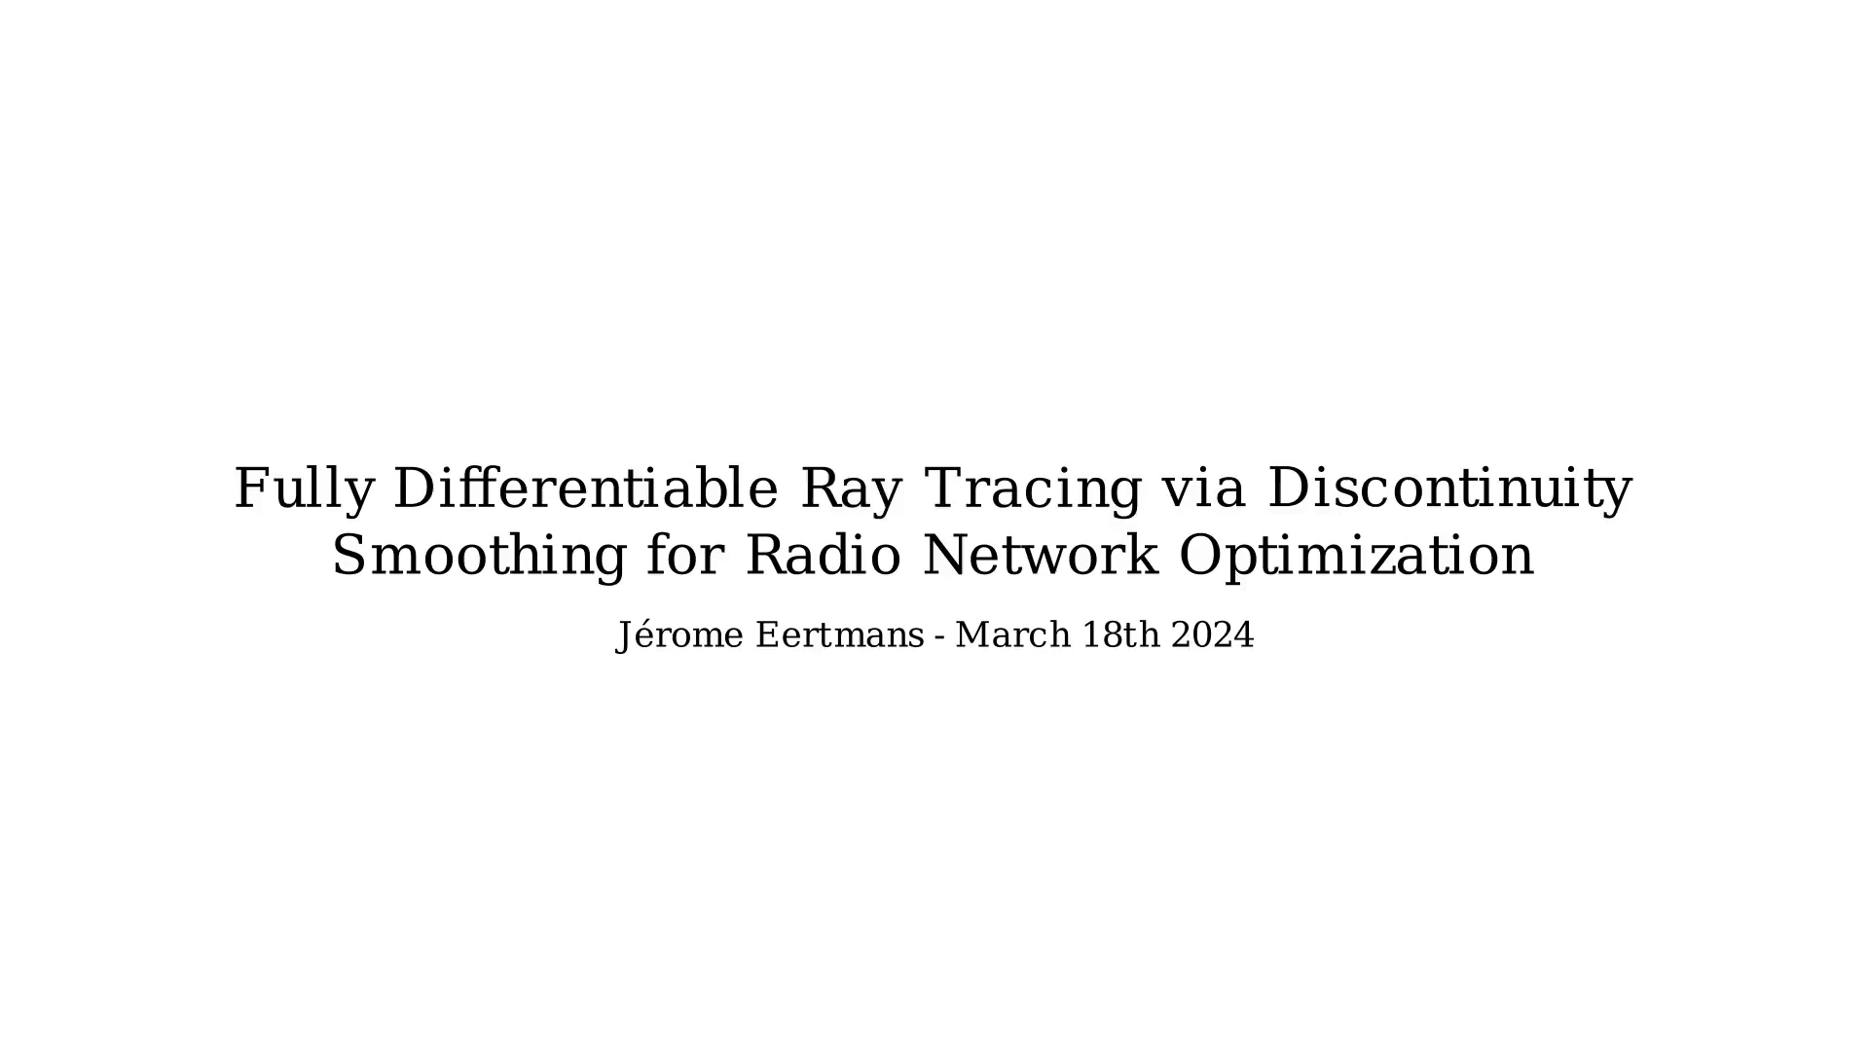
Notes:
# Differentiable Ray Tracing

Slide 3
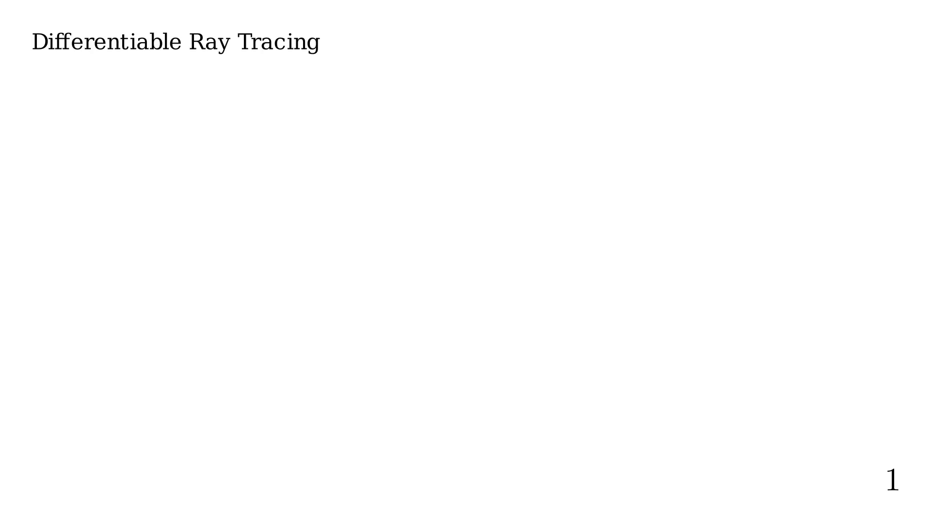
Notes:
RT has received an increased interest in the recent year the from
the radio propagation community.

Slide 4
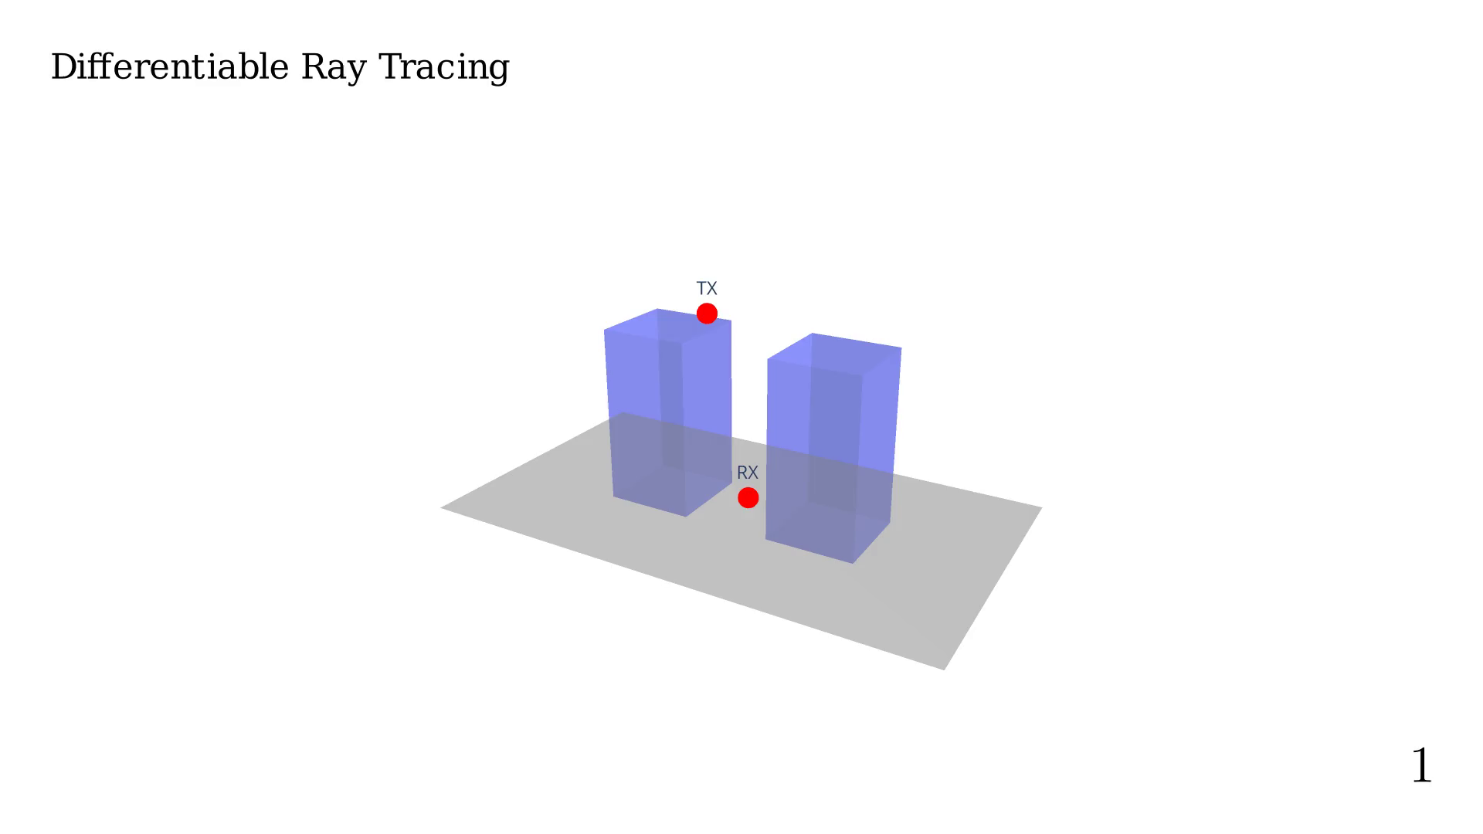
Notes:
Order = 0

Slide 5
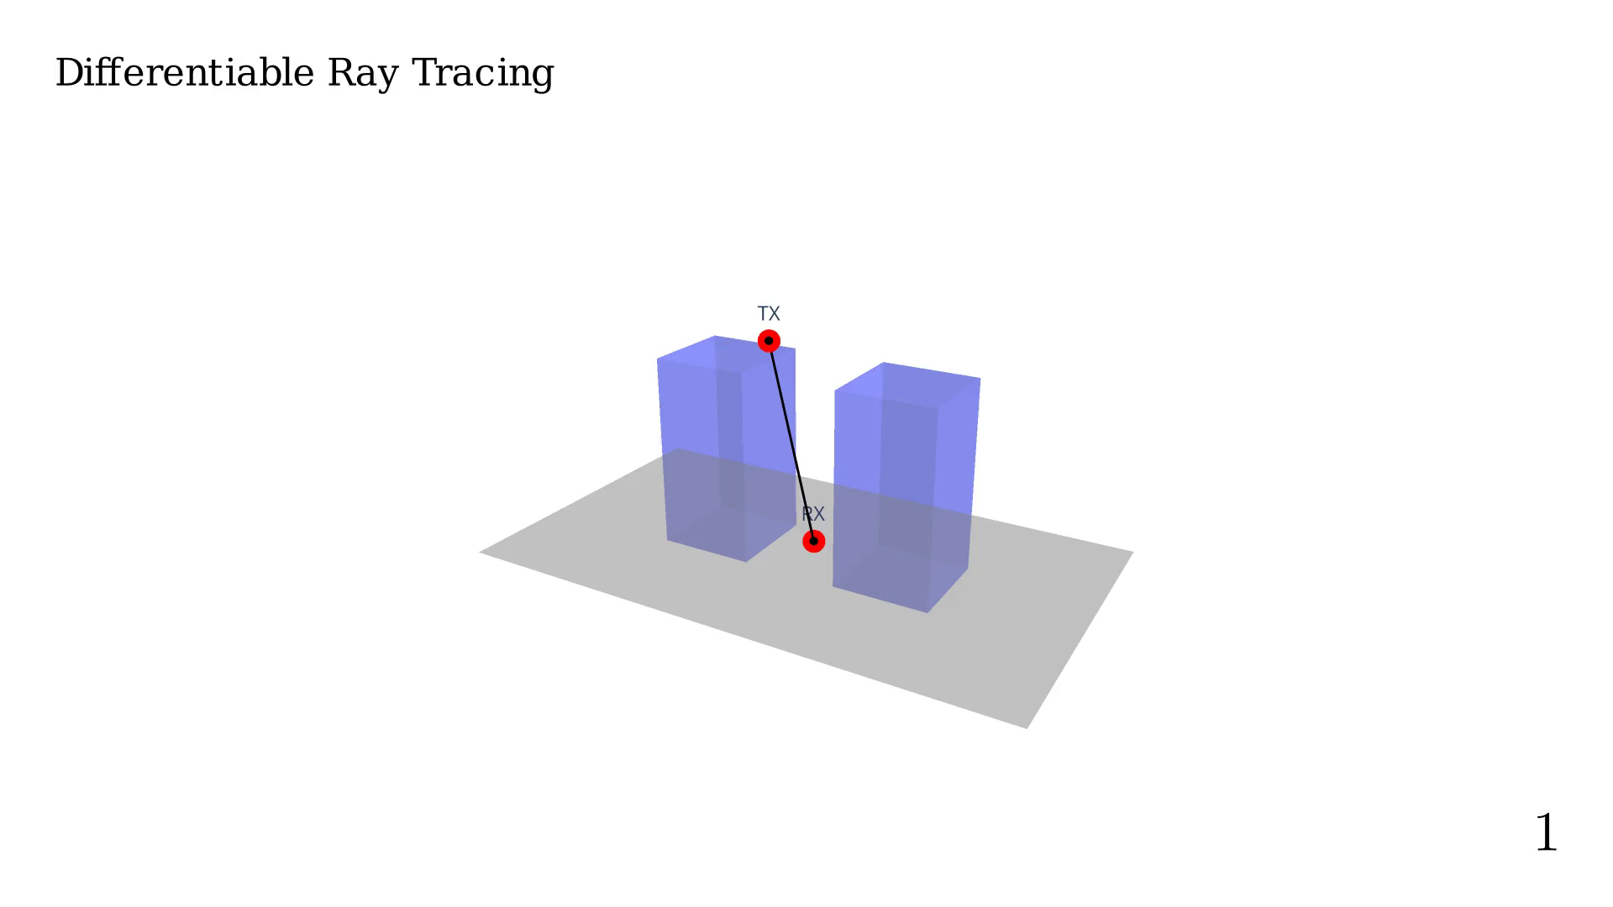
Notes:
Order = 1

Slide 6

Notes:
Order = 2

Slide 7

Notes:
Order = 3

Slide 8

Notes:
Order = 4

Slide 9

Notes:
We are often interested on computing the received
power as a function of the position.

Slide 10
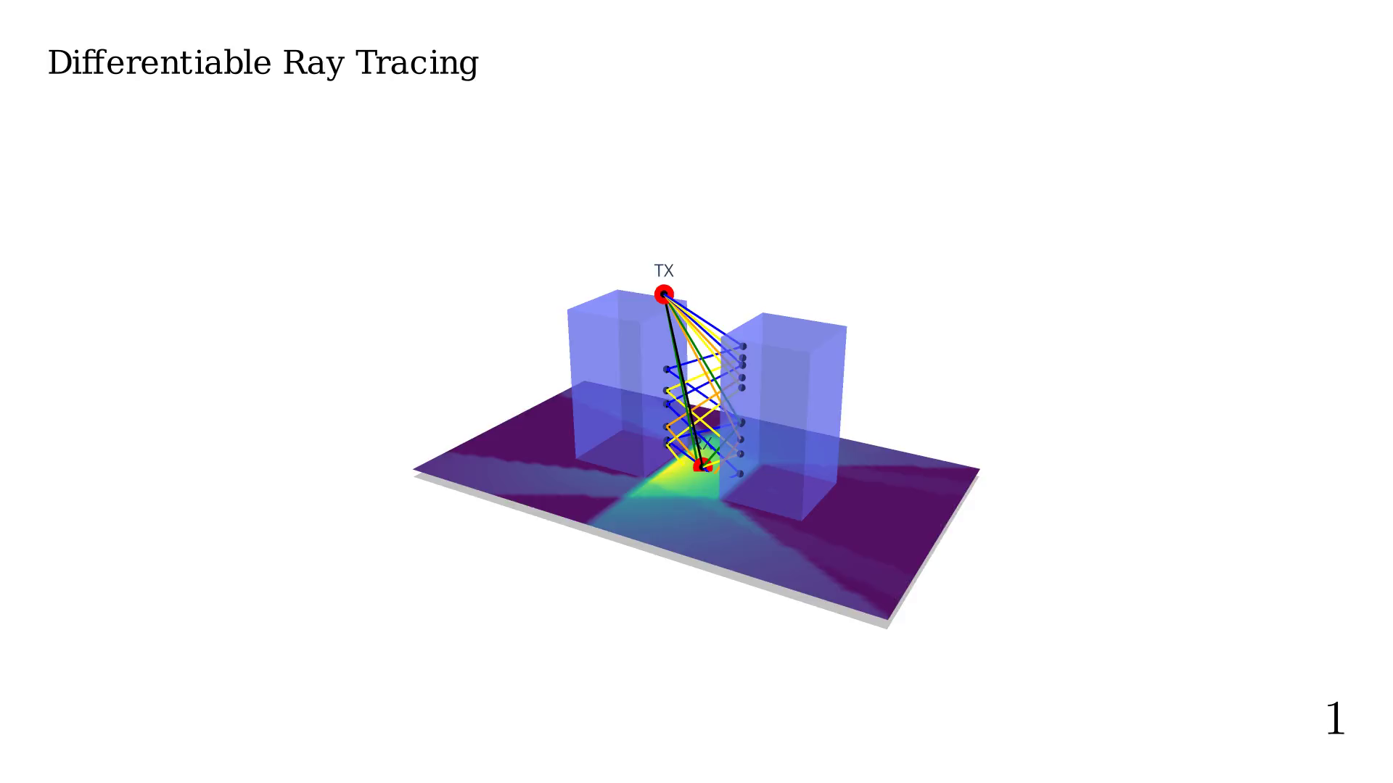
Notes:
Placing 'camera' on top X-Y view.
This gives us a very nice overview of what for call the
'coverage map'.

Slide 11
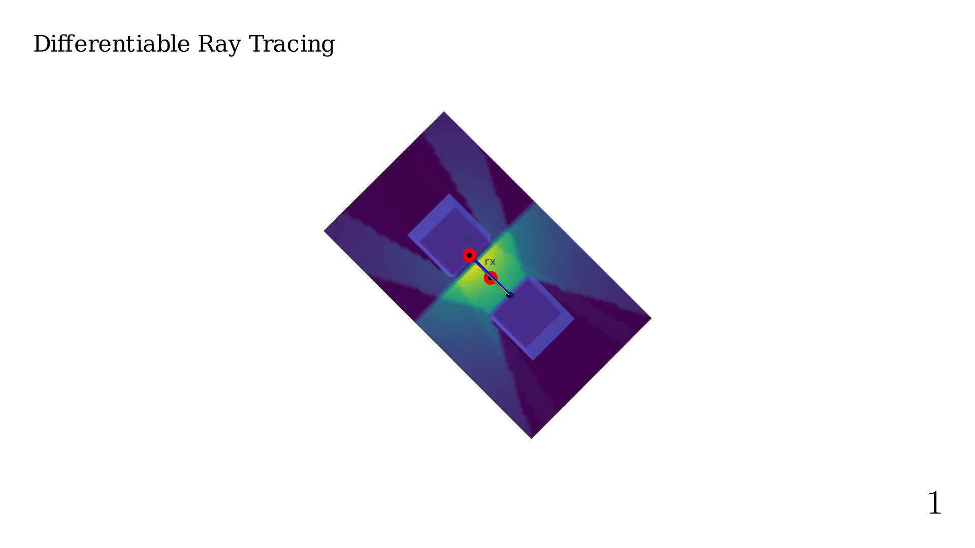
Notes:
Moving RX positiong to find the best position

Slide 12
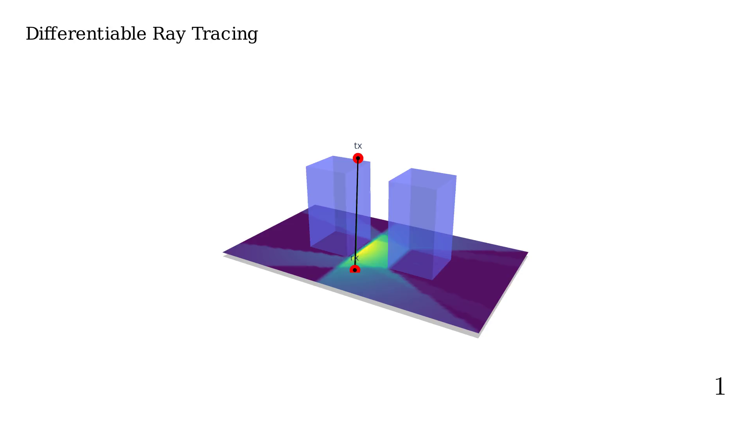
Notes:
Moving TX positiong to find the best position

Slide 13
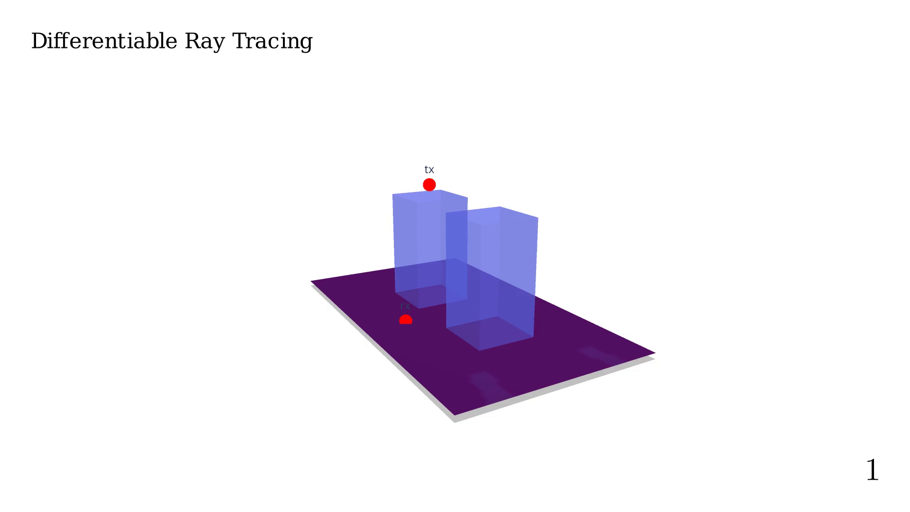
Notes:
Knowing the derivative would be useful...

Slide 14
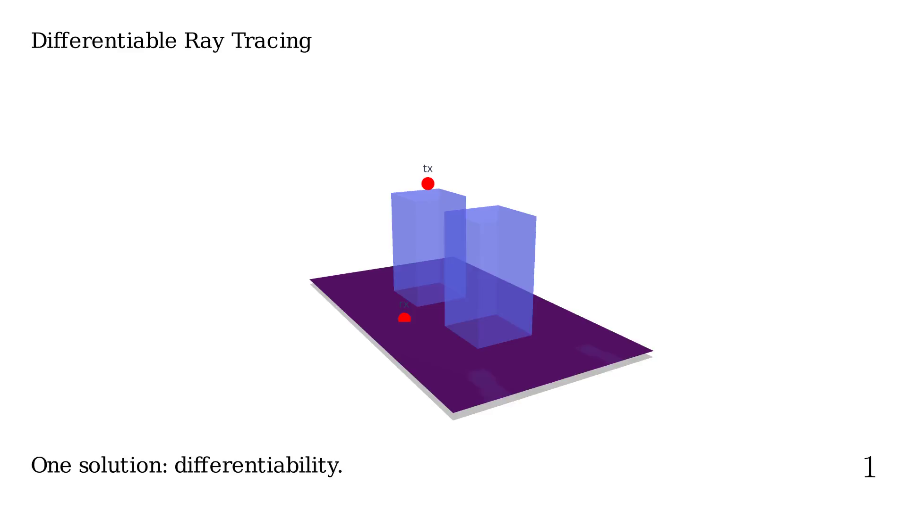
Notes:
Maybe one of the most recent and popular work on
DRT applied to radio-propagation is Sionna.

Slide 15
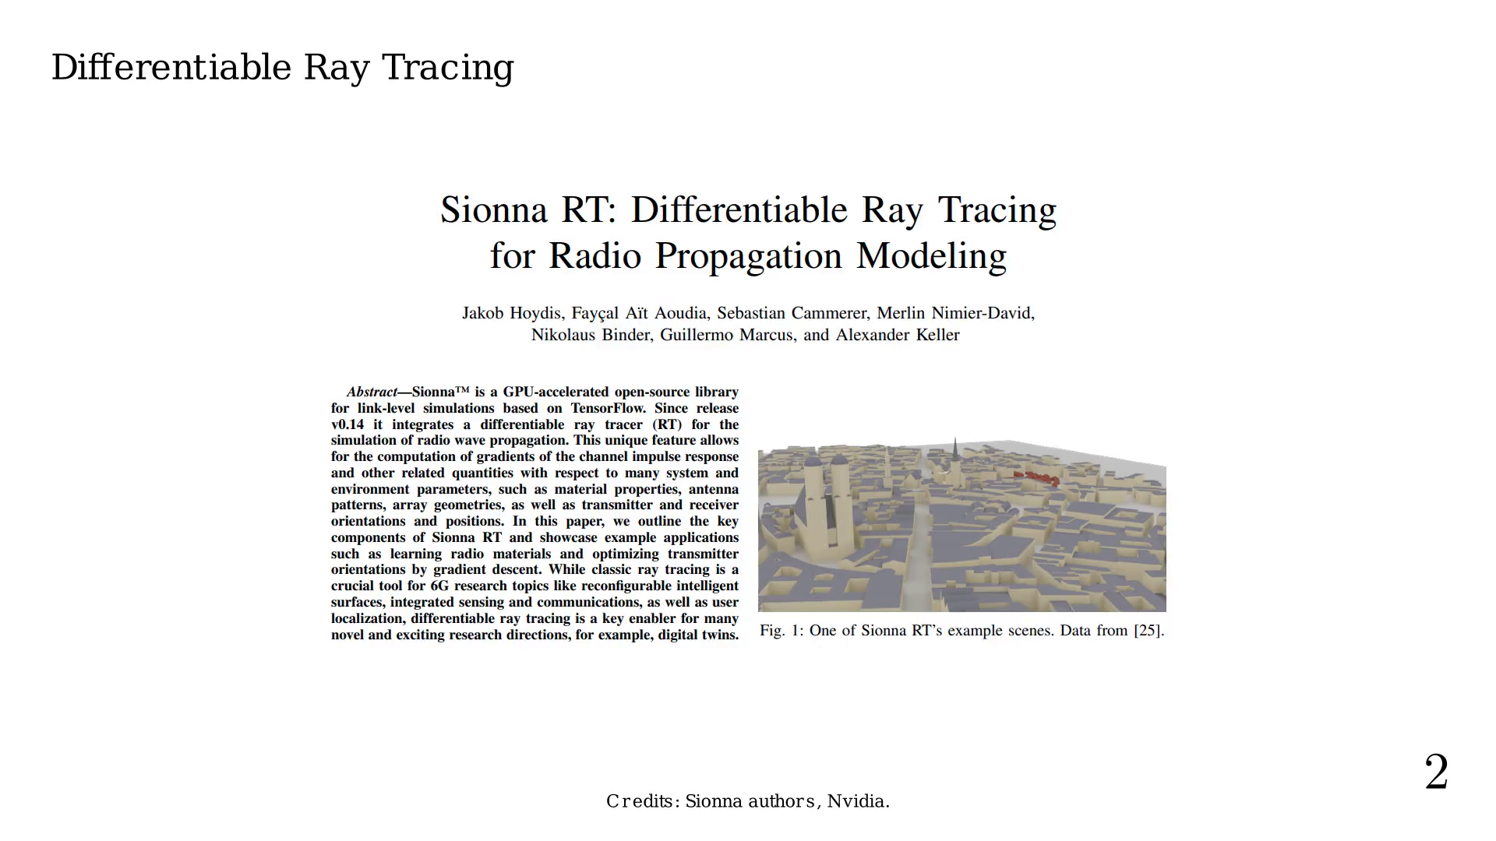
Notes:
Using auto-diff, they have created
an easy to use radio-network optimization tool.

Slide 16
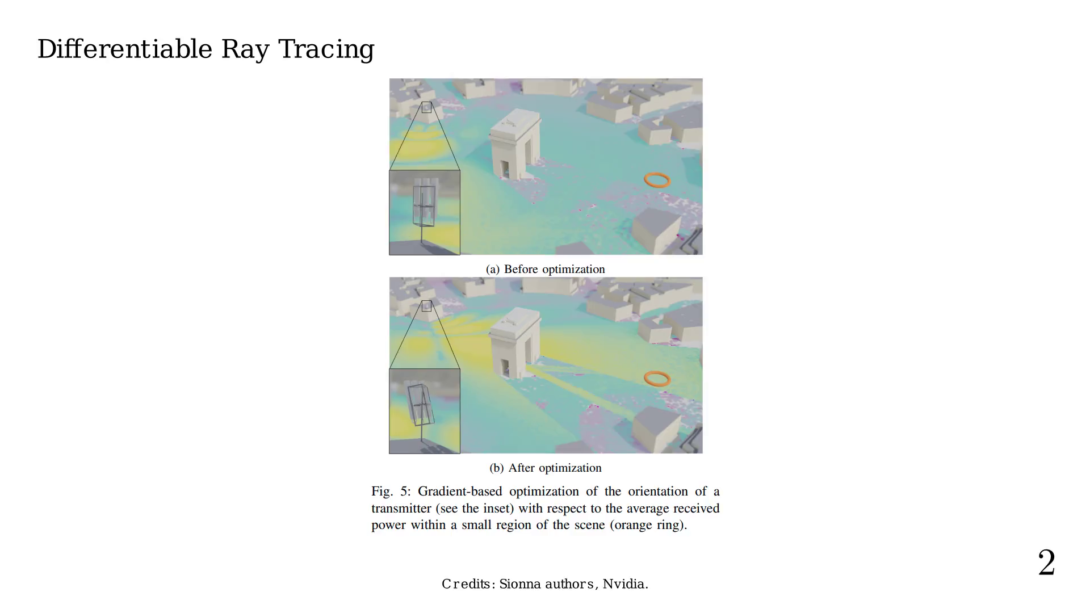
Notes:
RT's implementation presents many challenges,
mainly the exponential number of paths we can test.

Slide 17
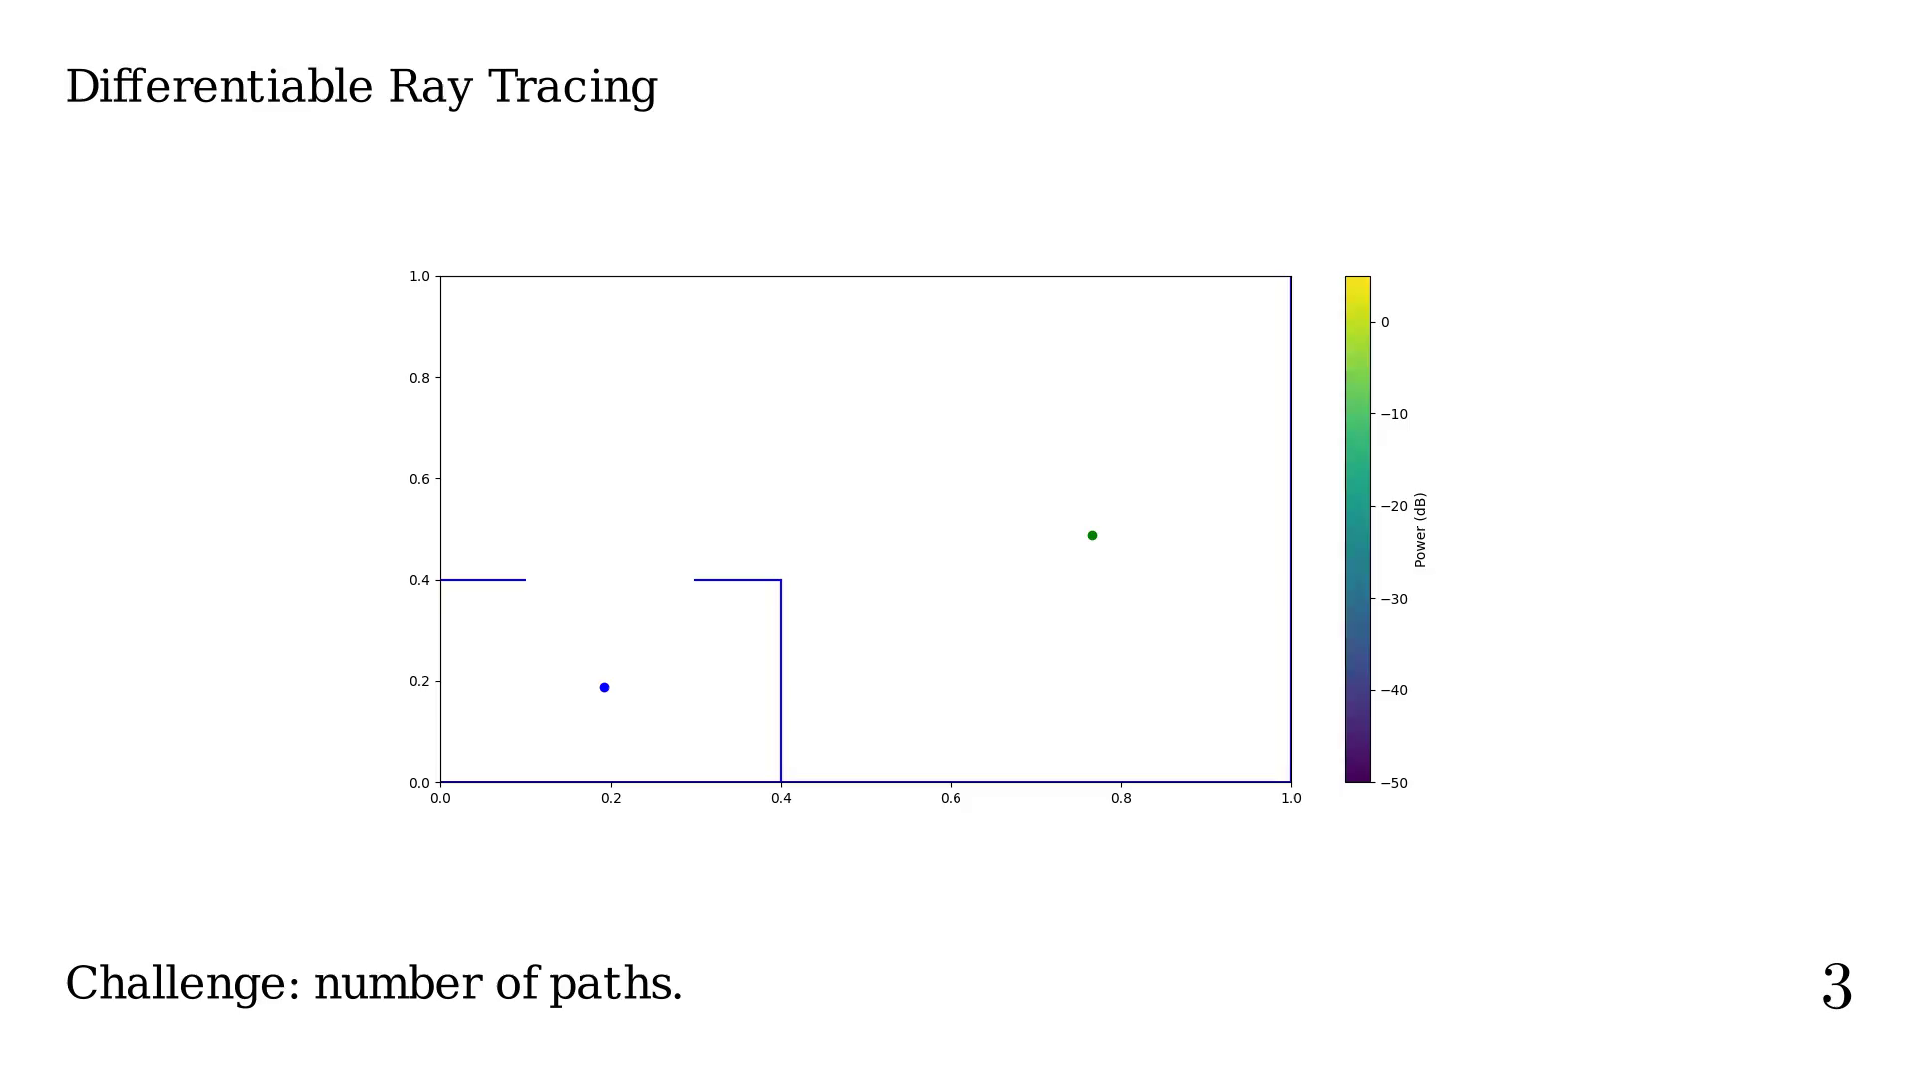
Notes:
Order = 0

Slide 18
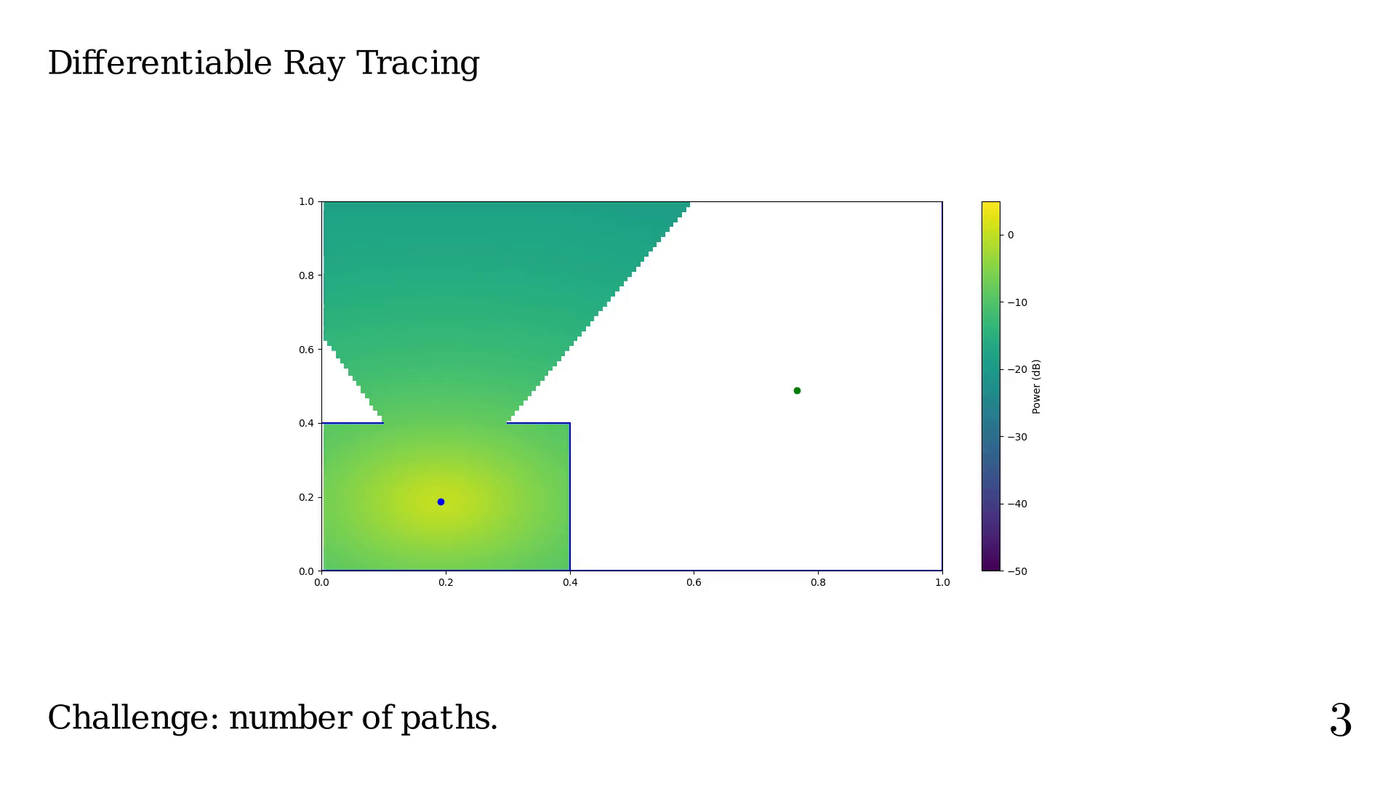
Notes:
Order = 1

Slide 19
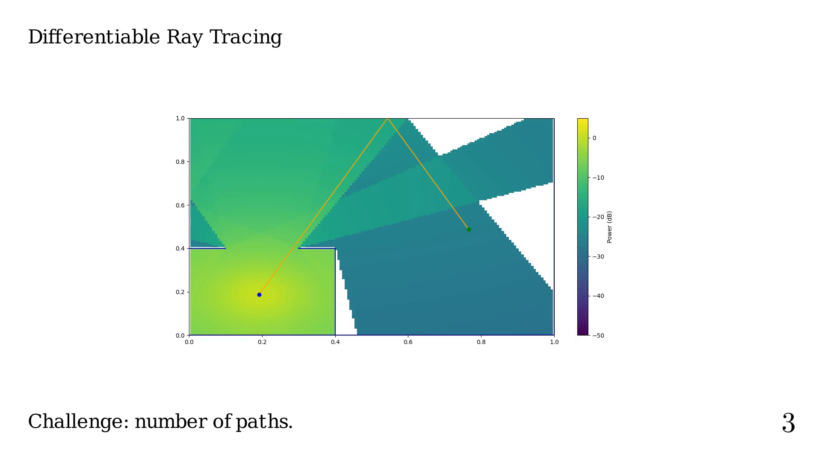
Notes:
Order = 2

Slide 20
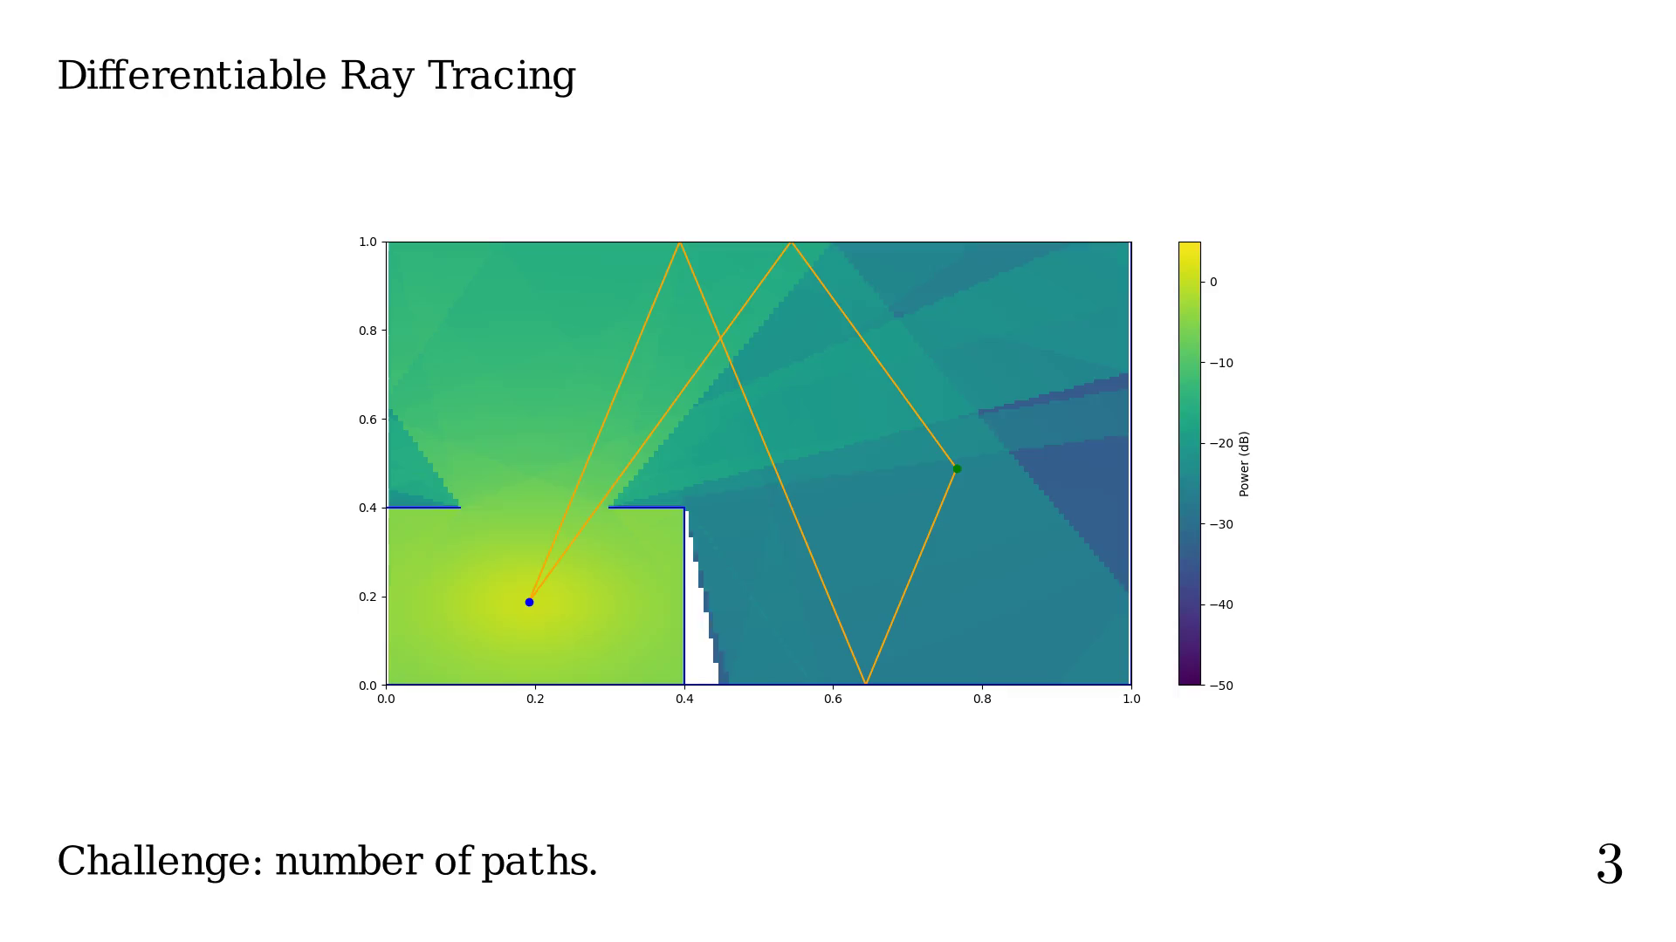
Notes:
Order = 3

Slide 21
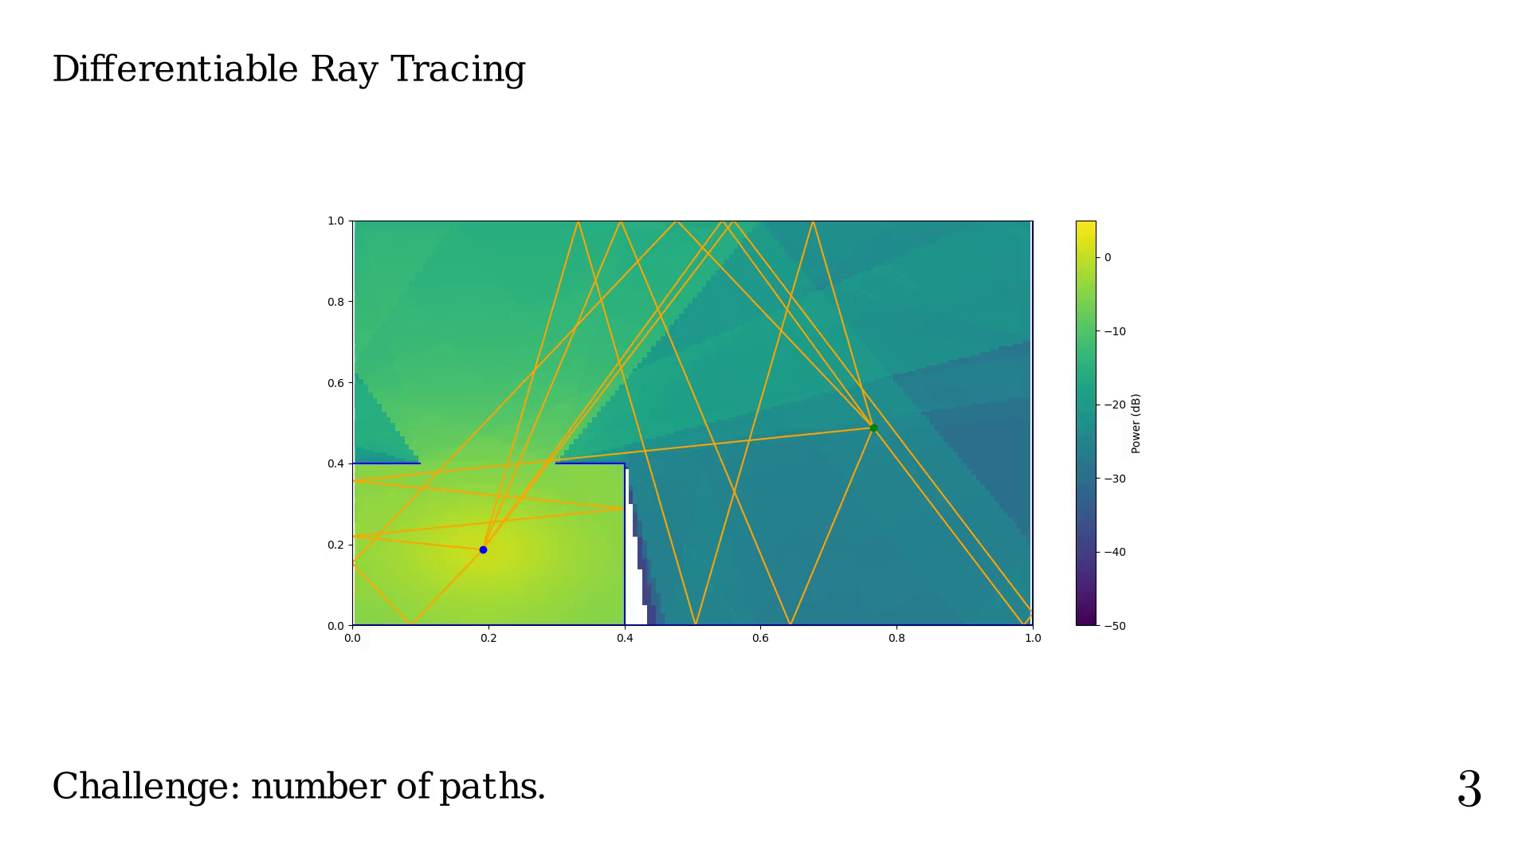
Notes:
Order = 4

Slide 22
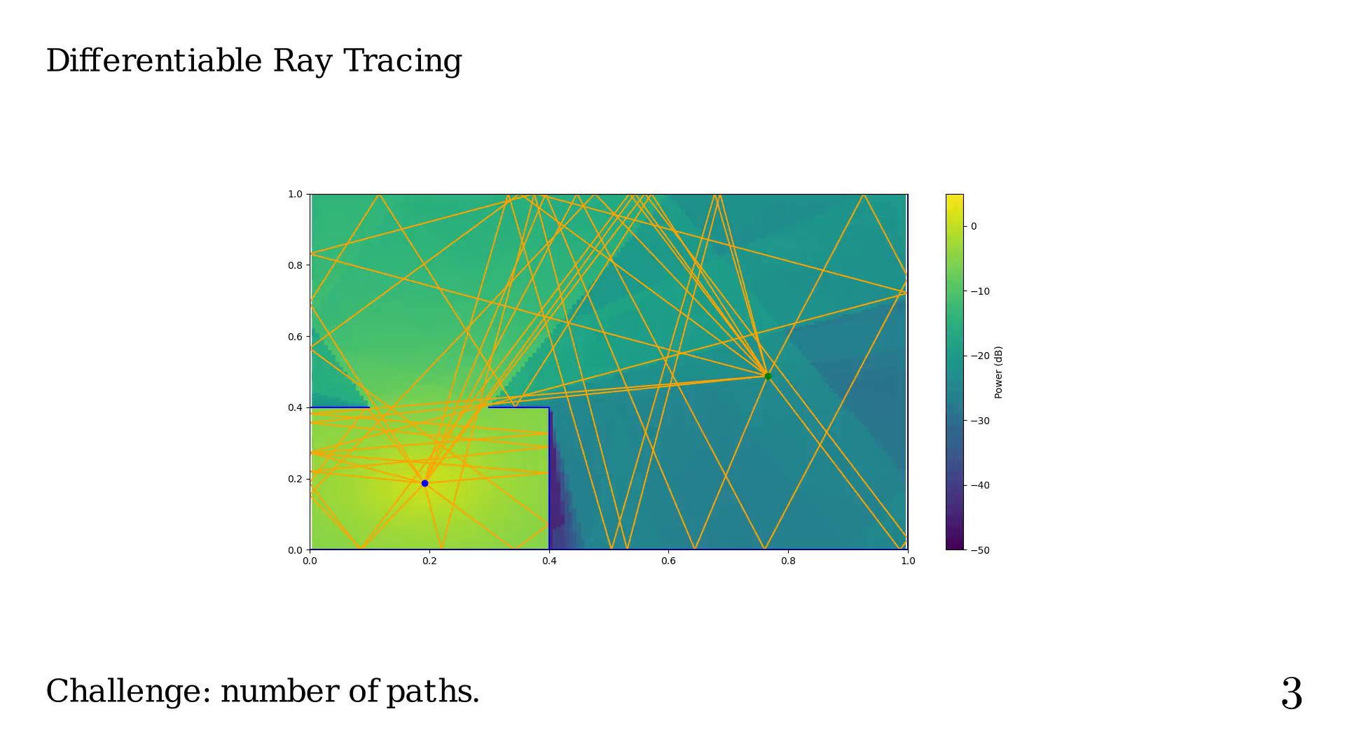
Notes:
Another challenge is the total path coverage versus
the order and types of interaction considered.

Slide 23
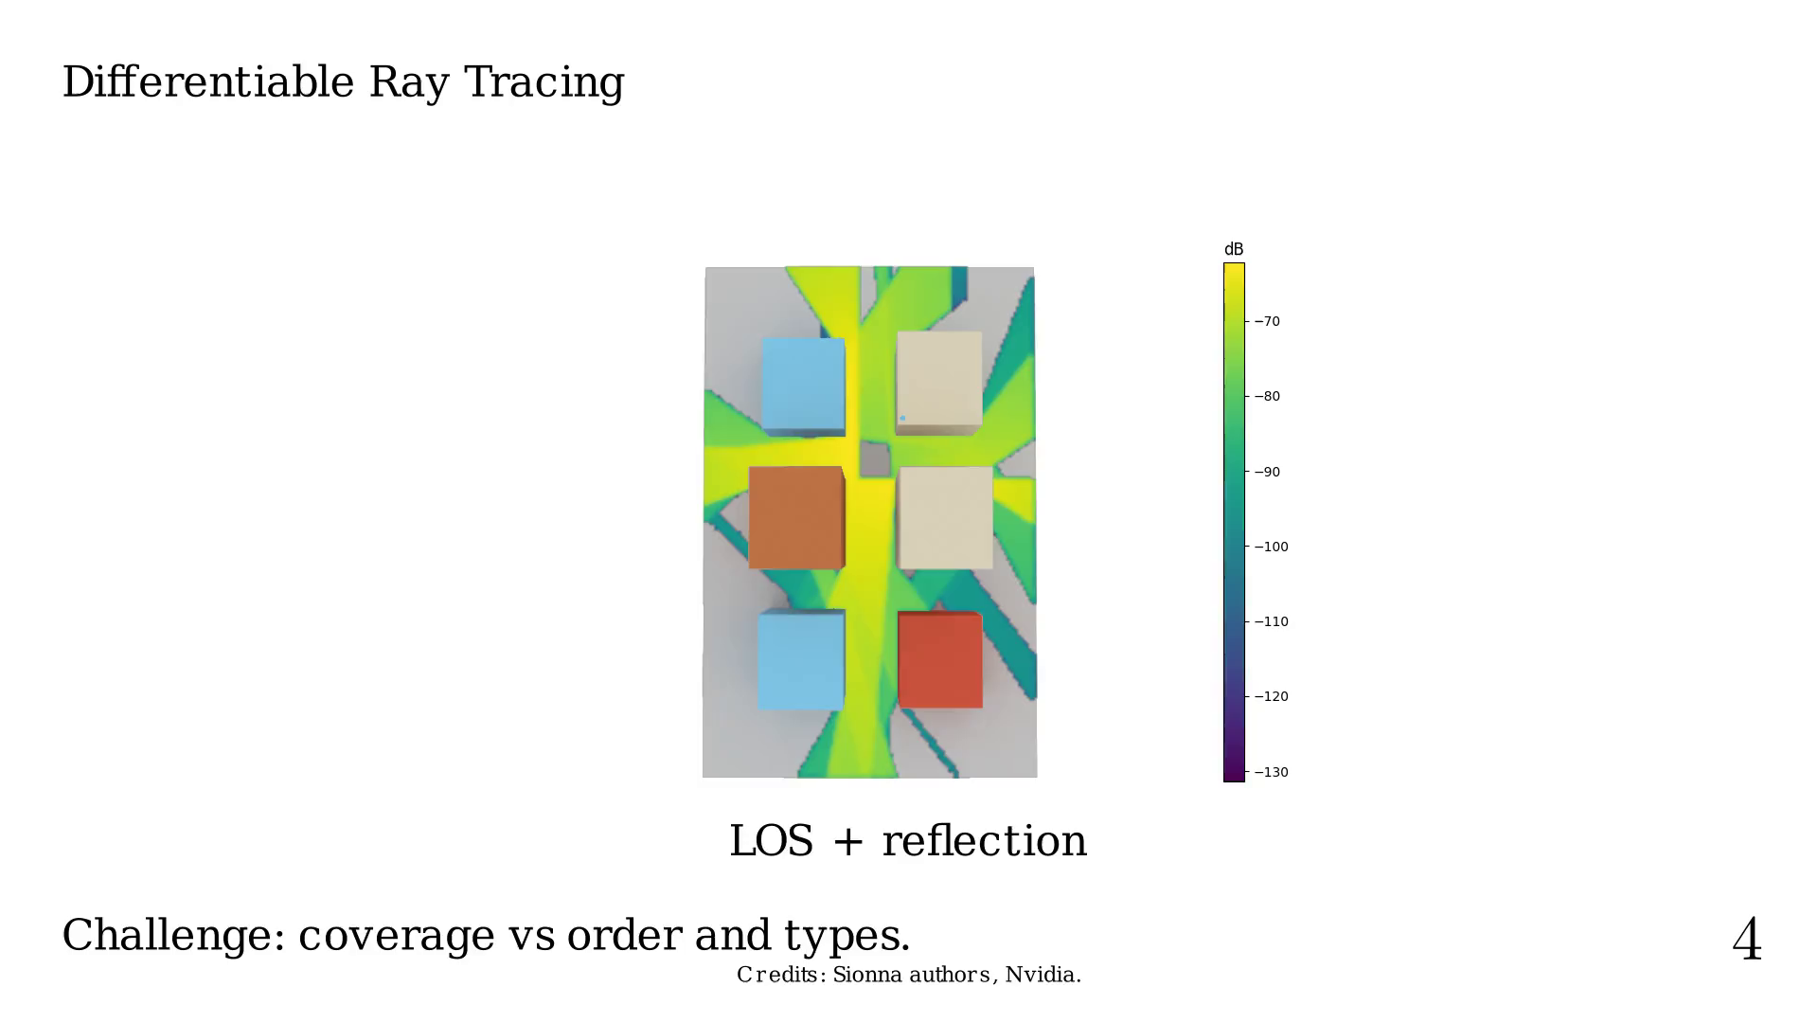
Notes:
If we add diffraction.

Slide 24
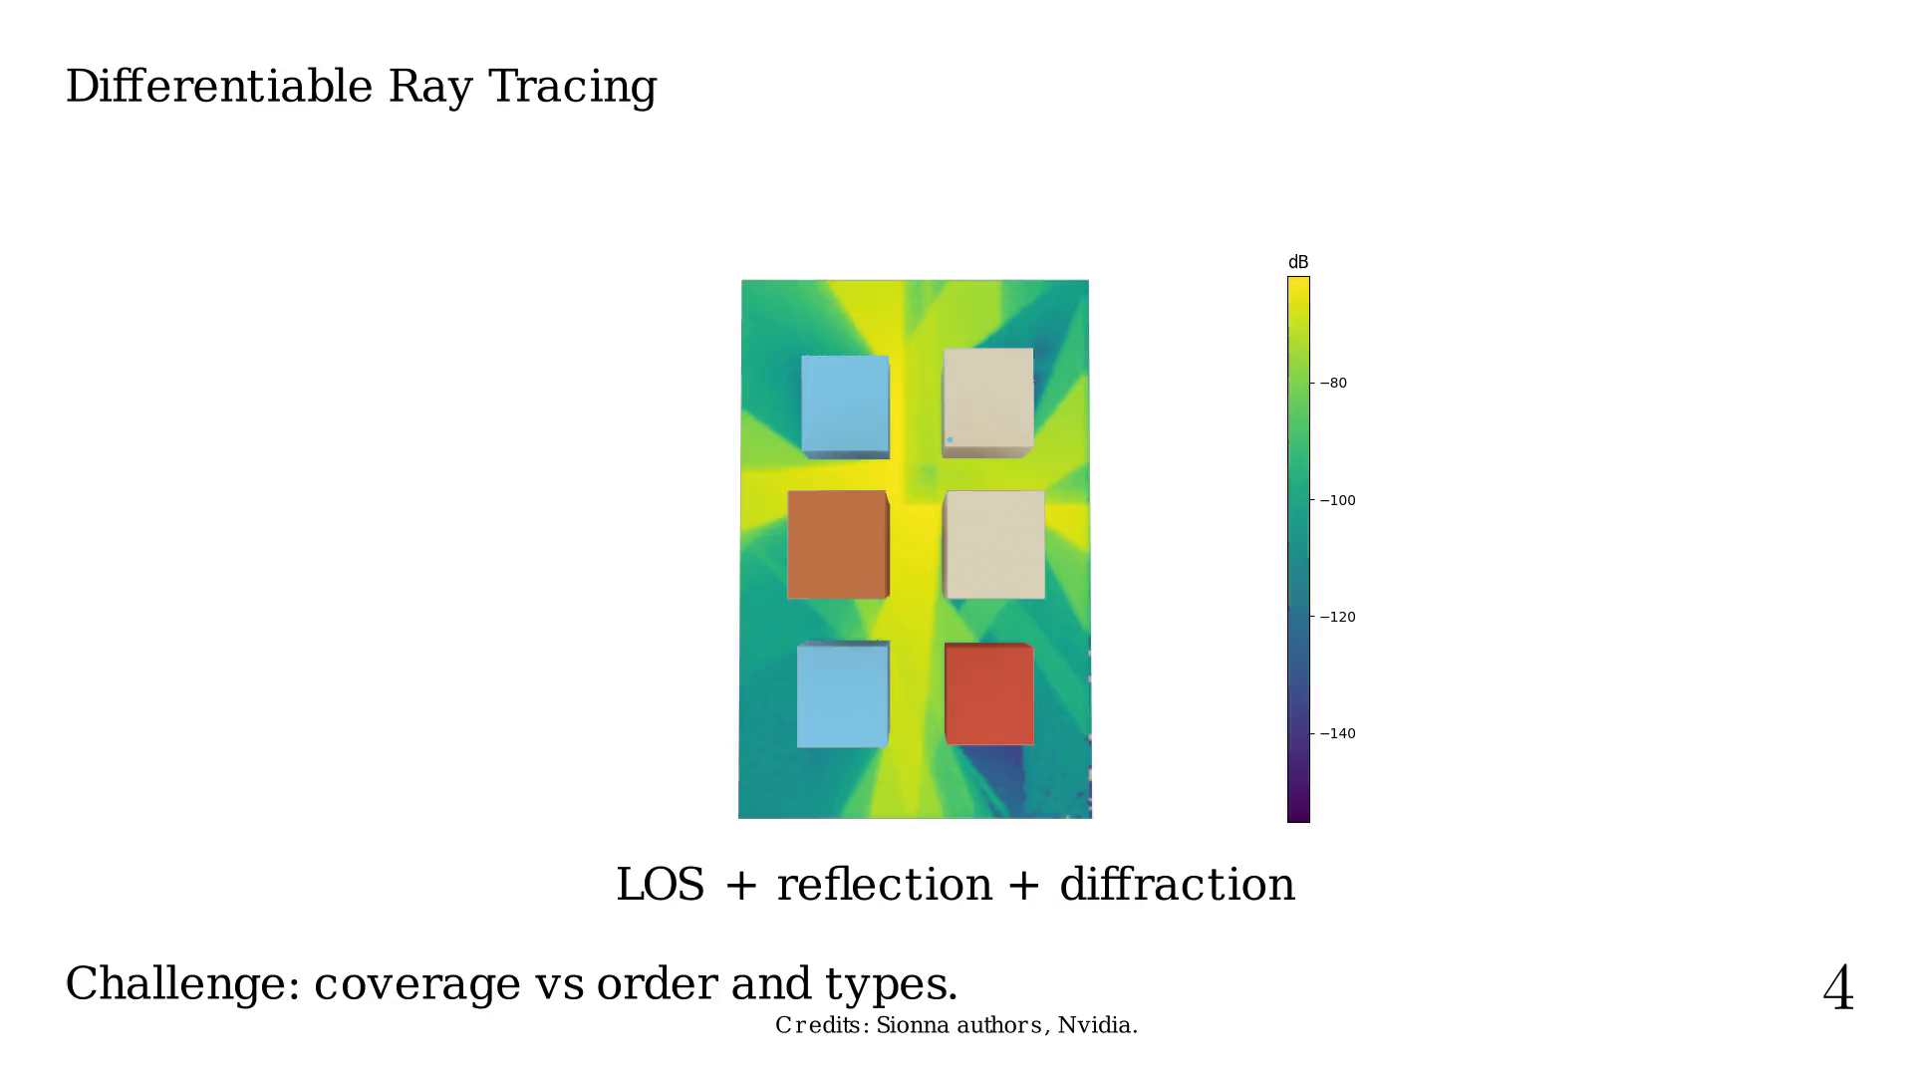
Notes:
Or if we add scattering.

Slide 25
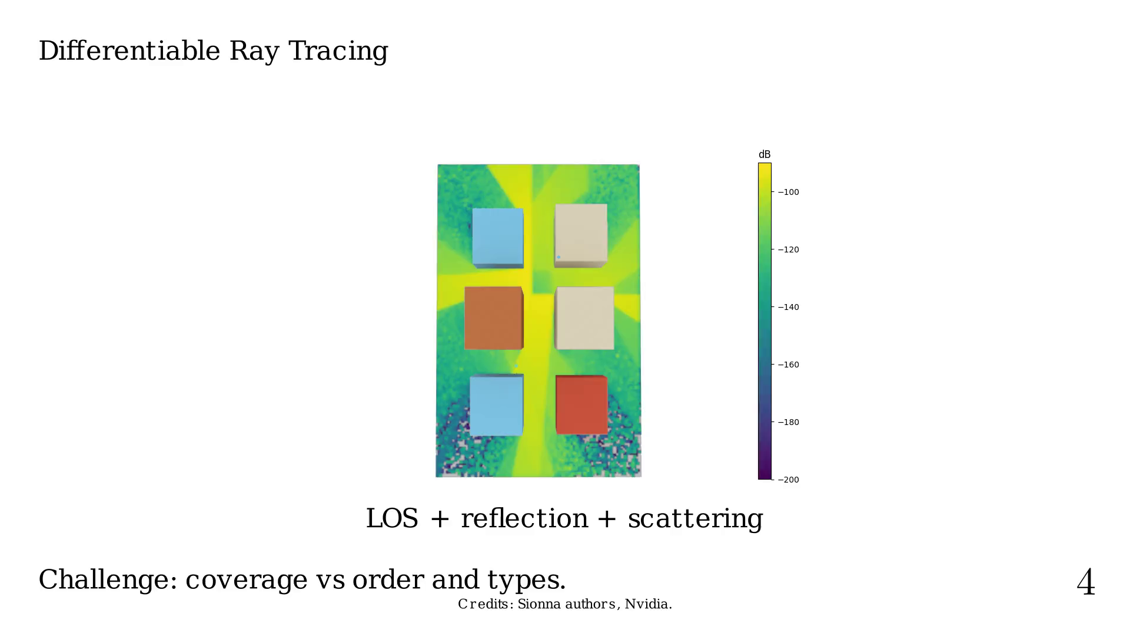
Notes:
Without those (possible infinitely) high-order
paths or complex interaction types, we have "holes"
in our domain, which is an issue for gradient-based
optimization.
What if we could have a fake transparancy that would
fake a possible link between RX and TX?

Slide 26
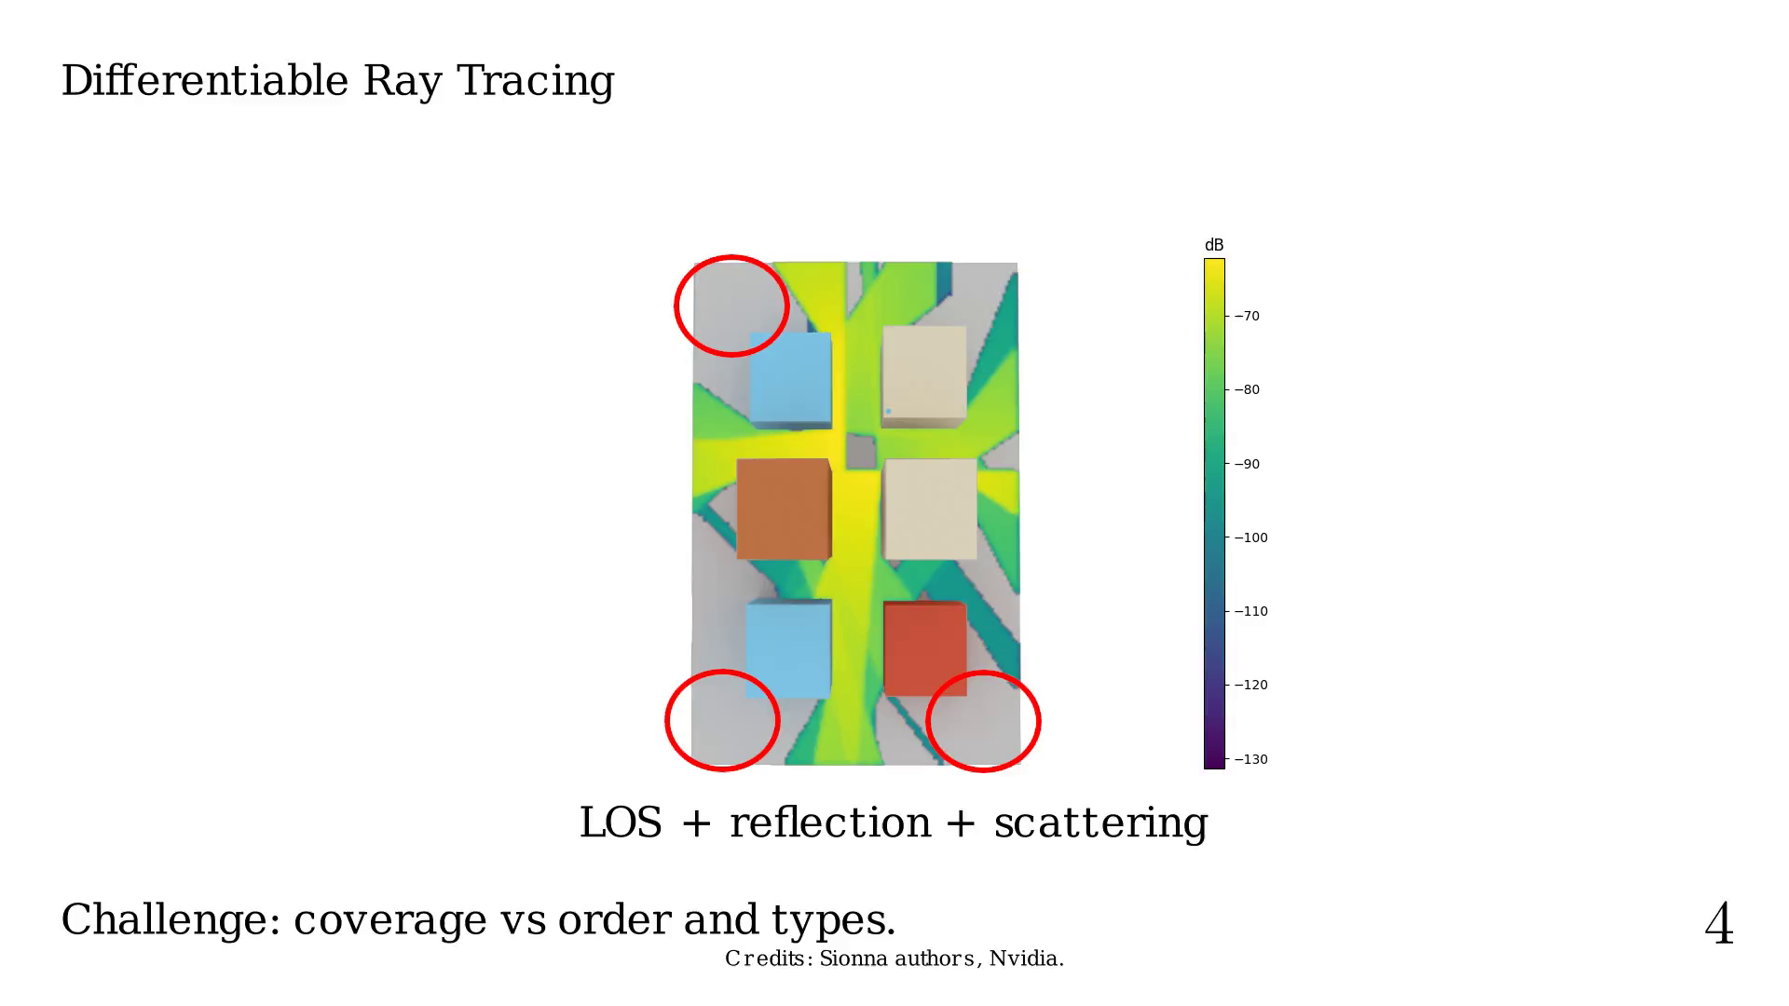
Notes:
Present work and contents

Slide 27
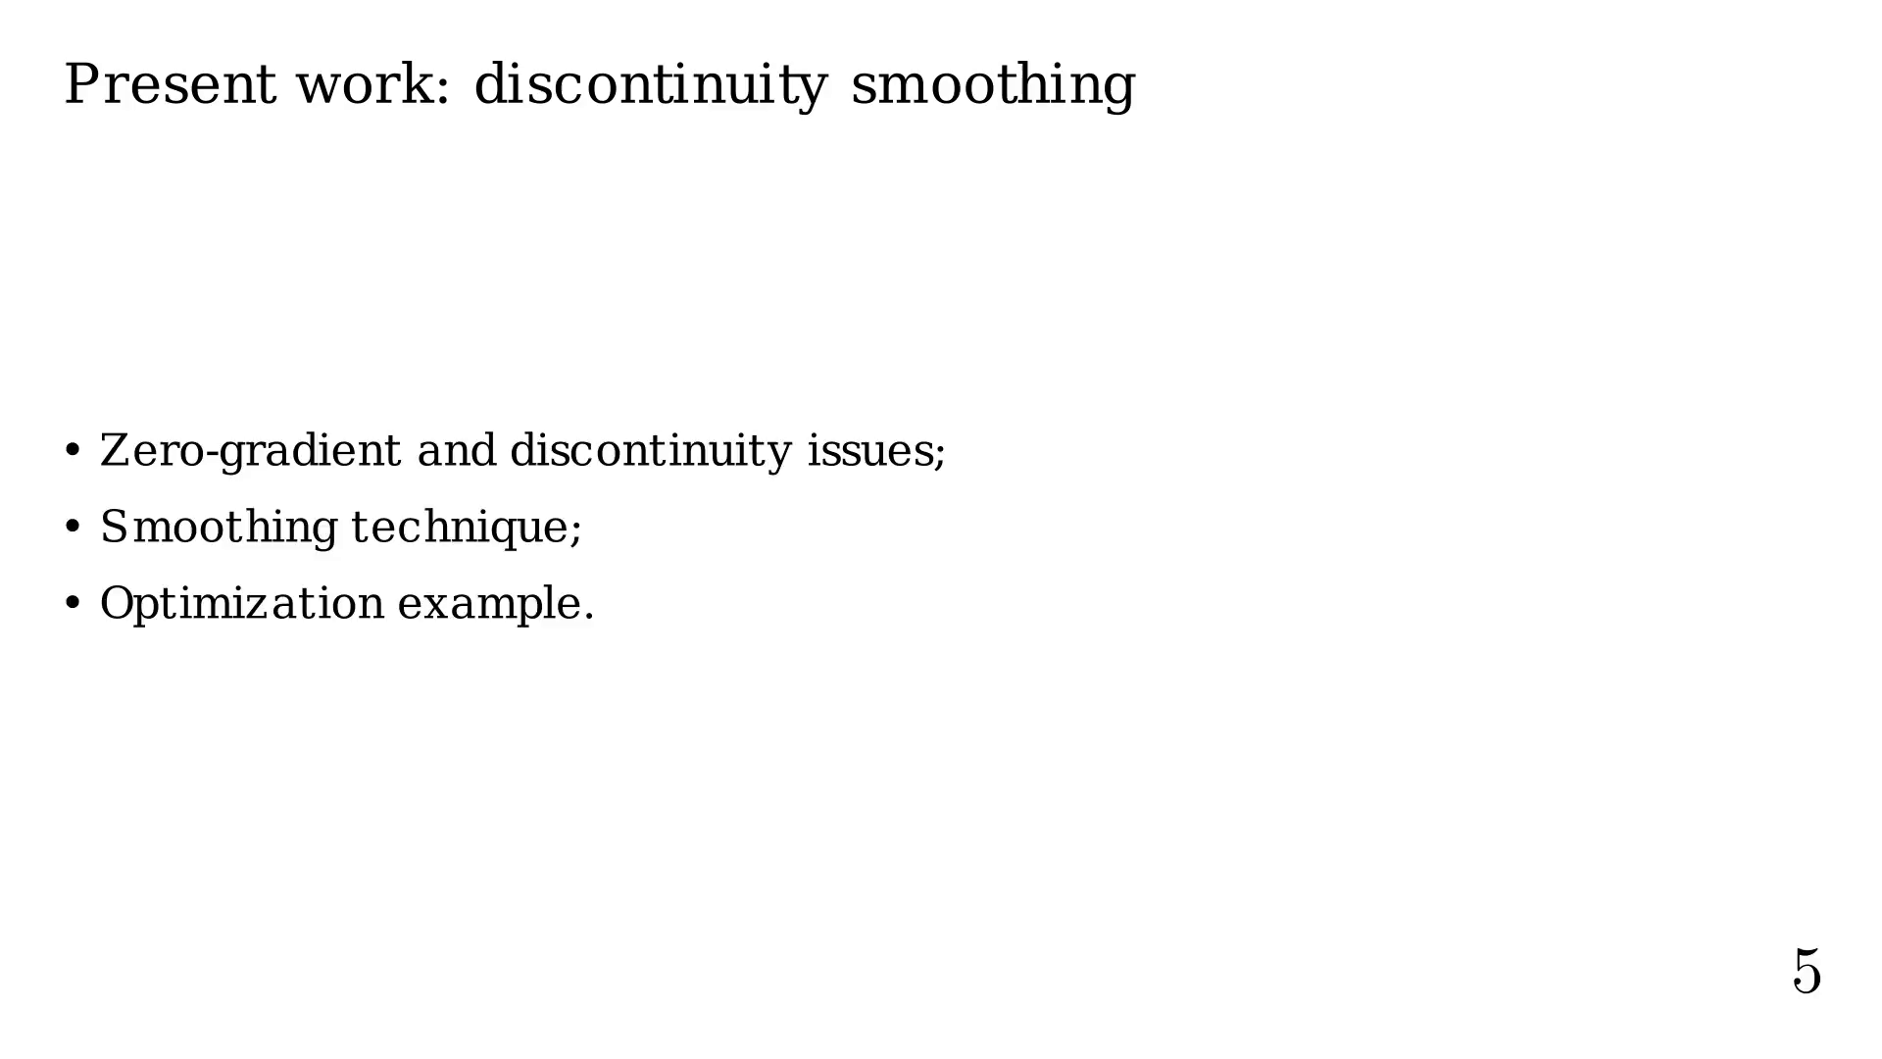
Notes:
Our problem is only piecewise diff. and continuous.

Slide 28
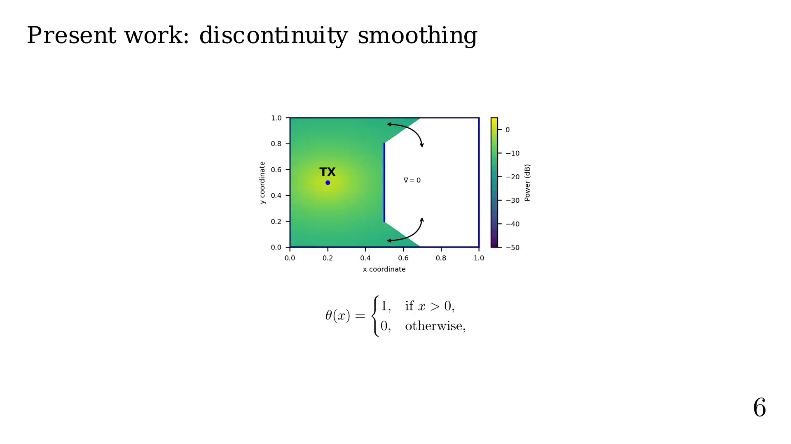
Notes:
Constraints about our approximation.

Slide 29
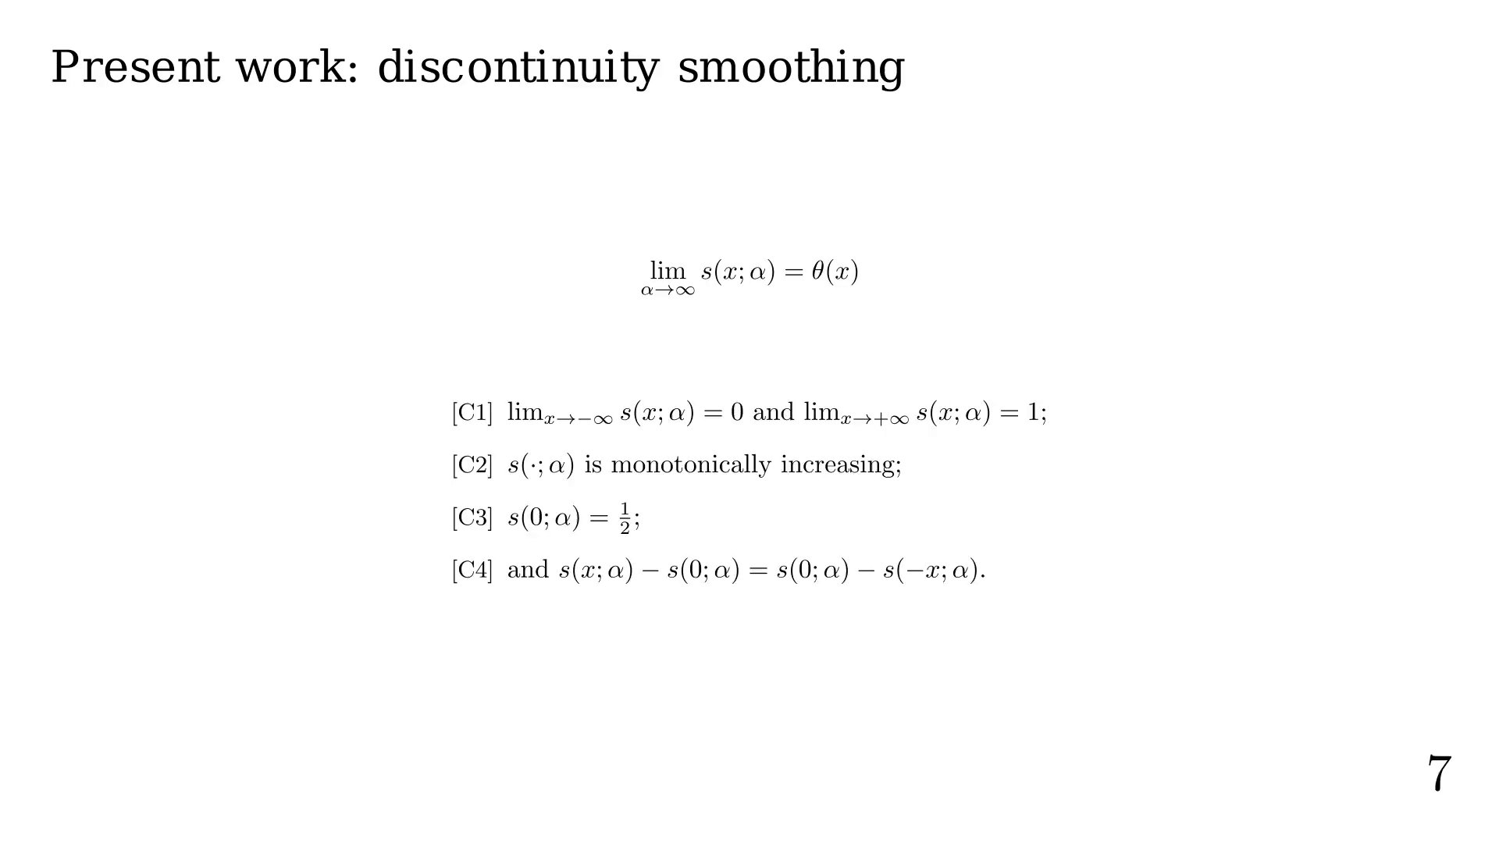
Notes:
Examples.

Slide 30
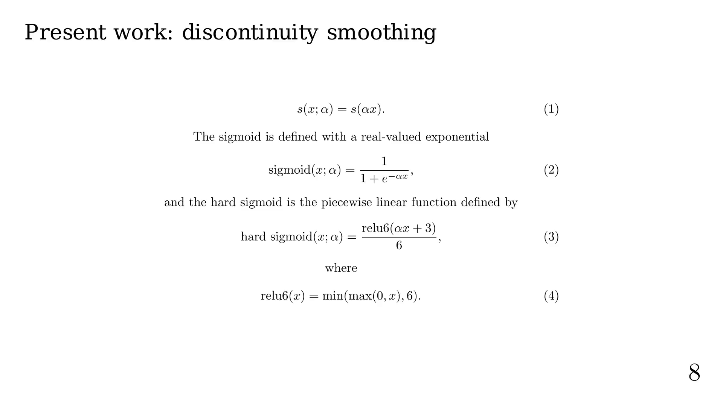

Slide 31
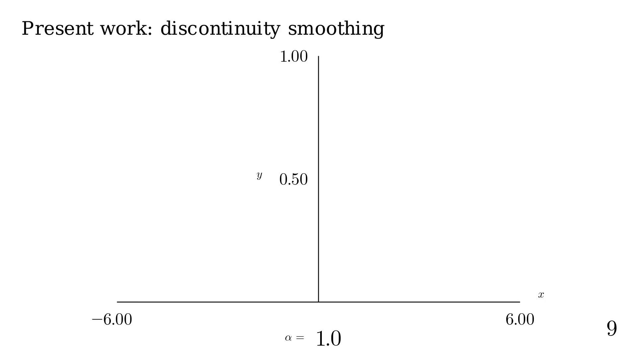

Slide 32
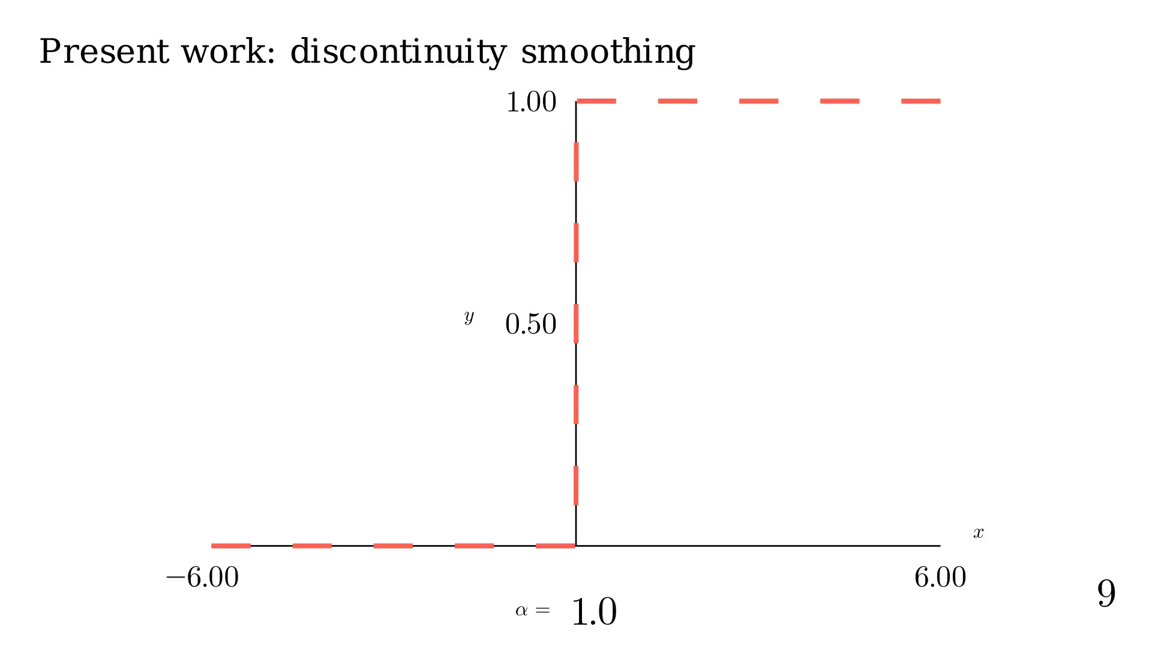

Slide 33
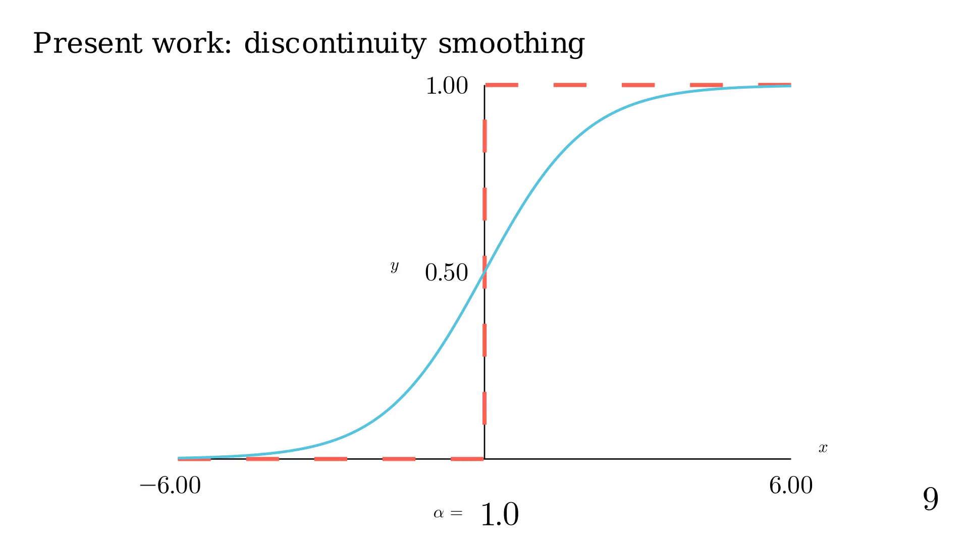

Slide 34
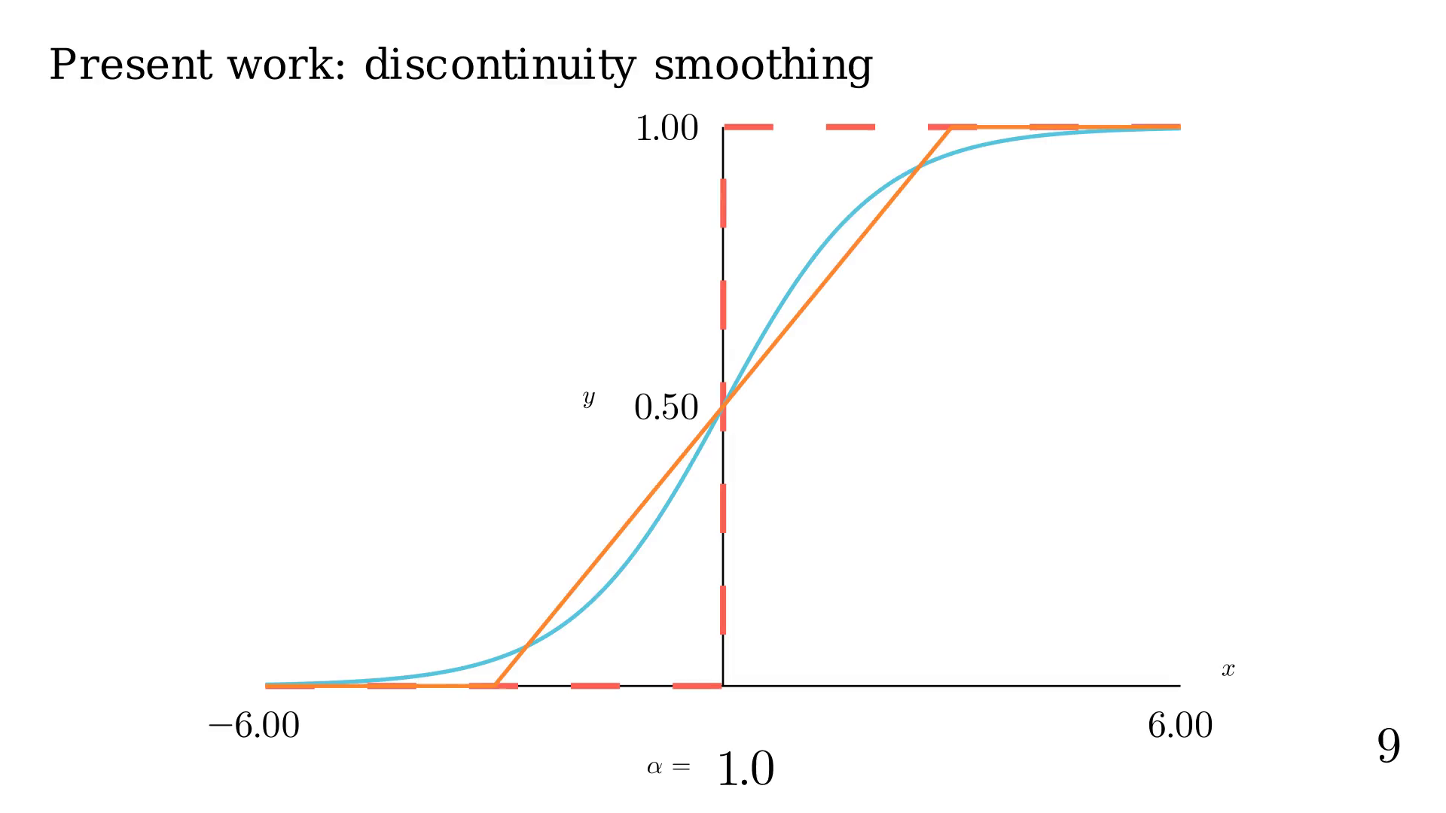
Notes:
Let's animate alpha.

Slide 35
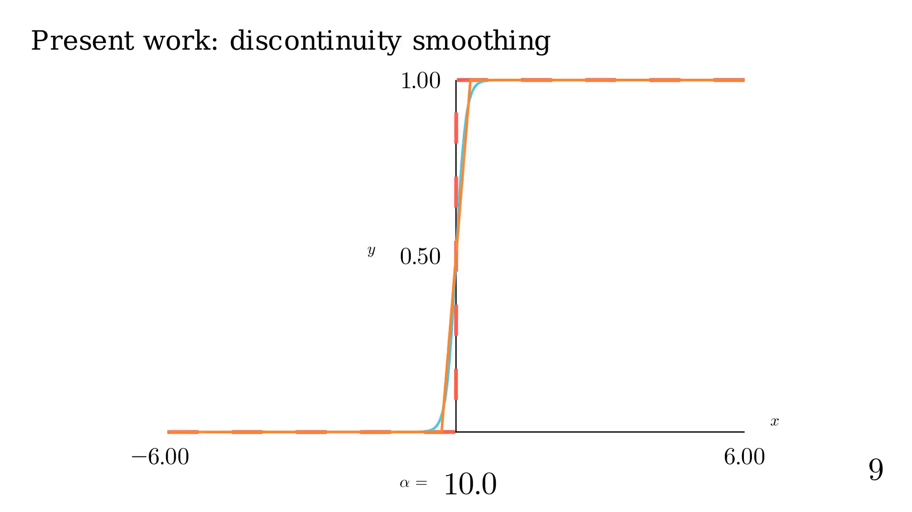
Notes:
Thanks to that, and other things, we can create a fully DRT!

Slide 36
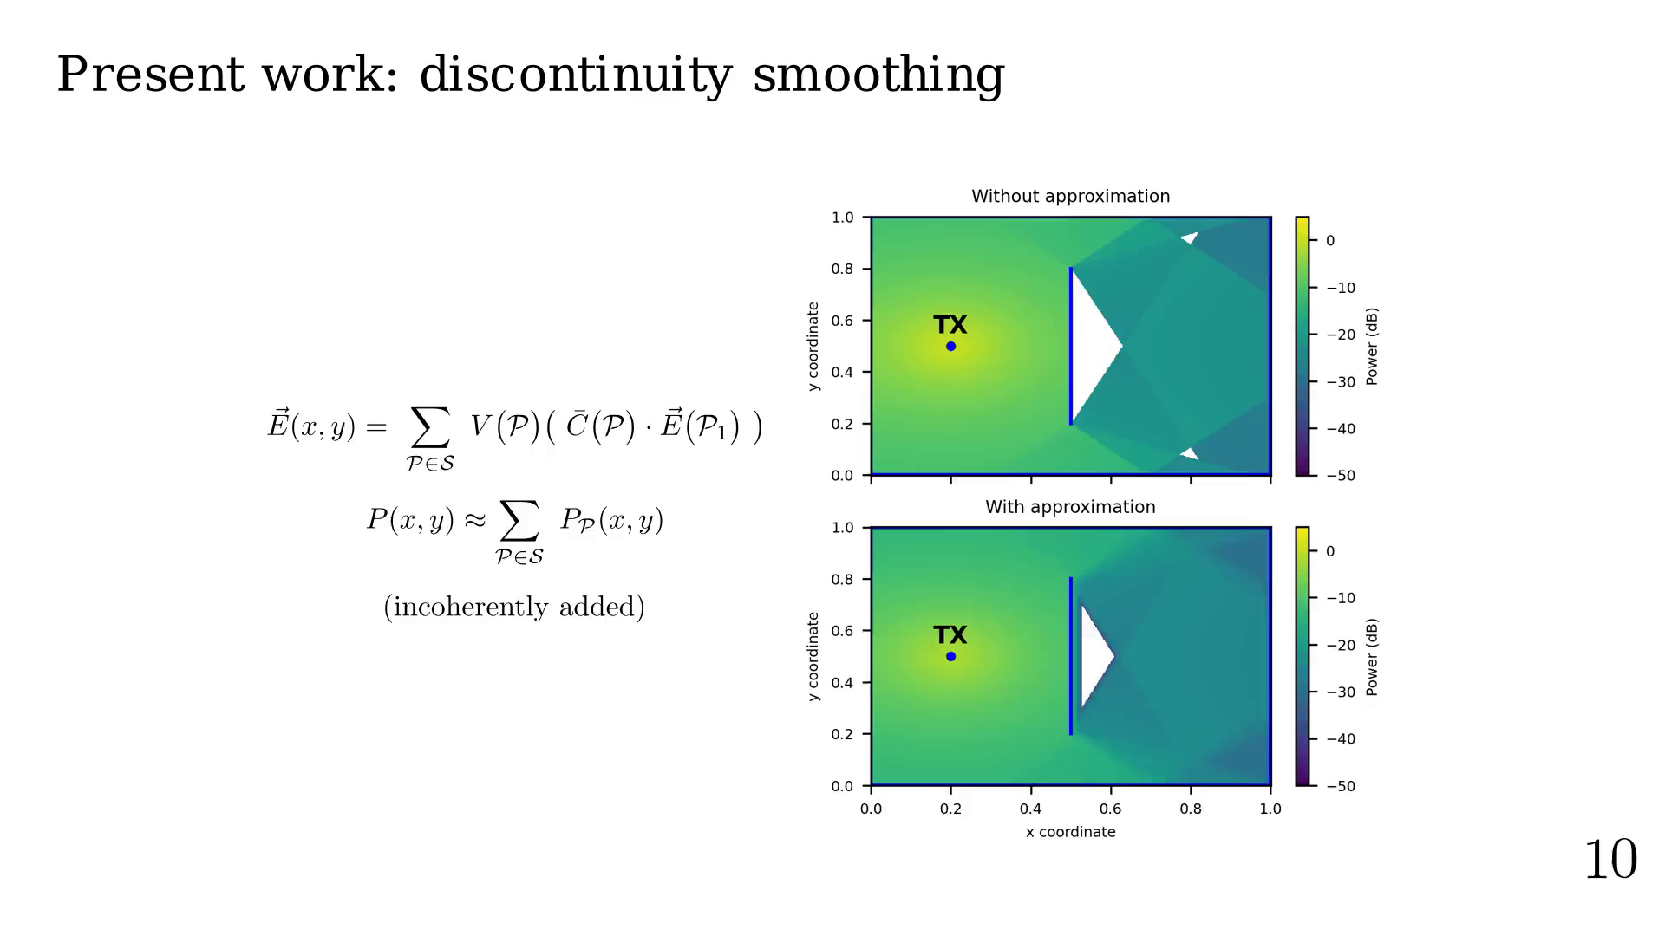
Notes:
We can create an optimization problem.

Slide 37
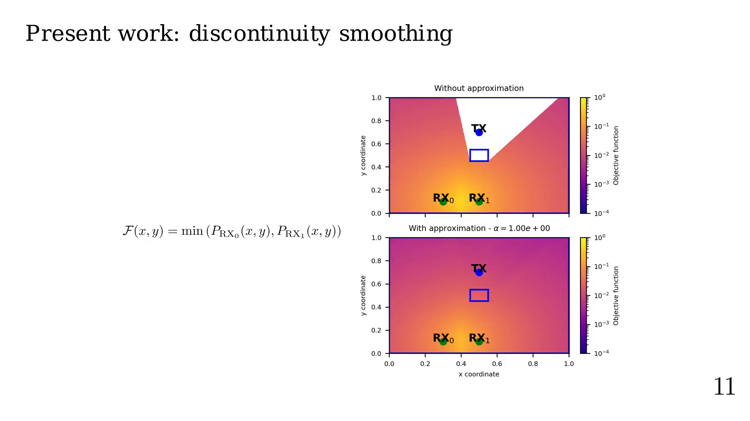
Notes:
Let's see how it converge.

Slide 38
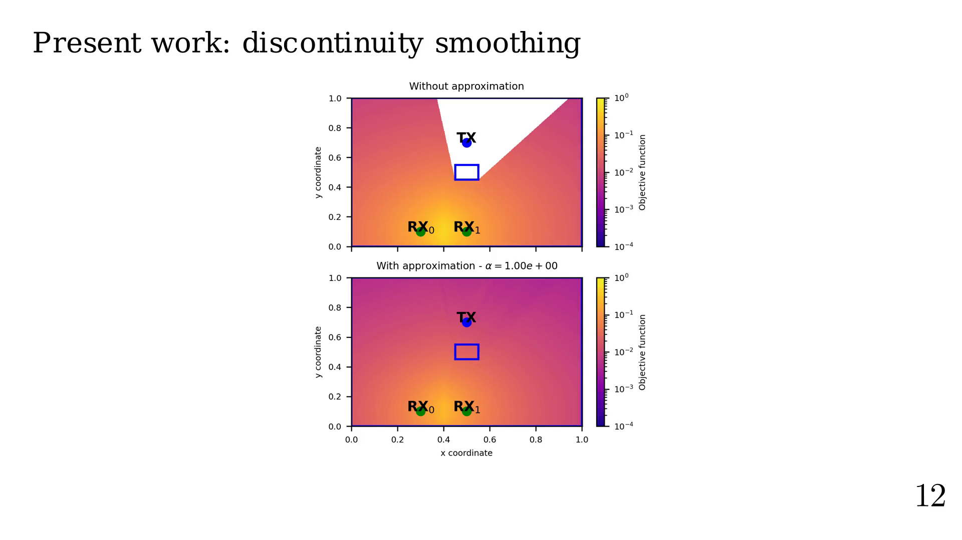
Notes:
Showing steps

Slide 39
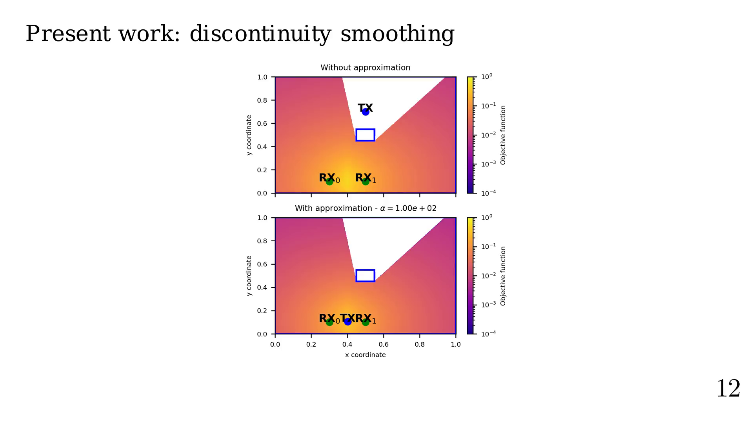
Notes:
Actually, tests have shown:
1.5 to 2 increase in success rate,
where 92% to 98% of already successful runs still converge
with our method.

Slide 40
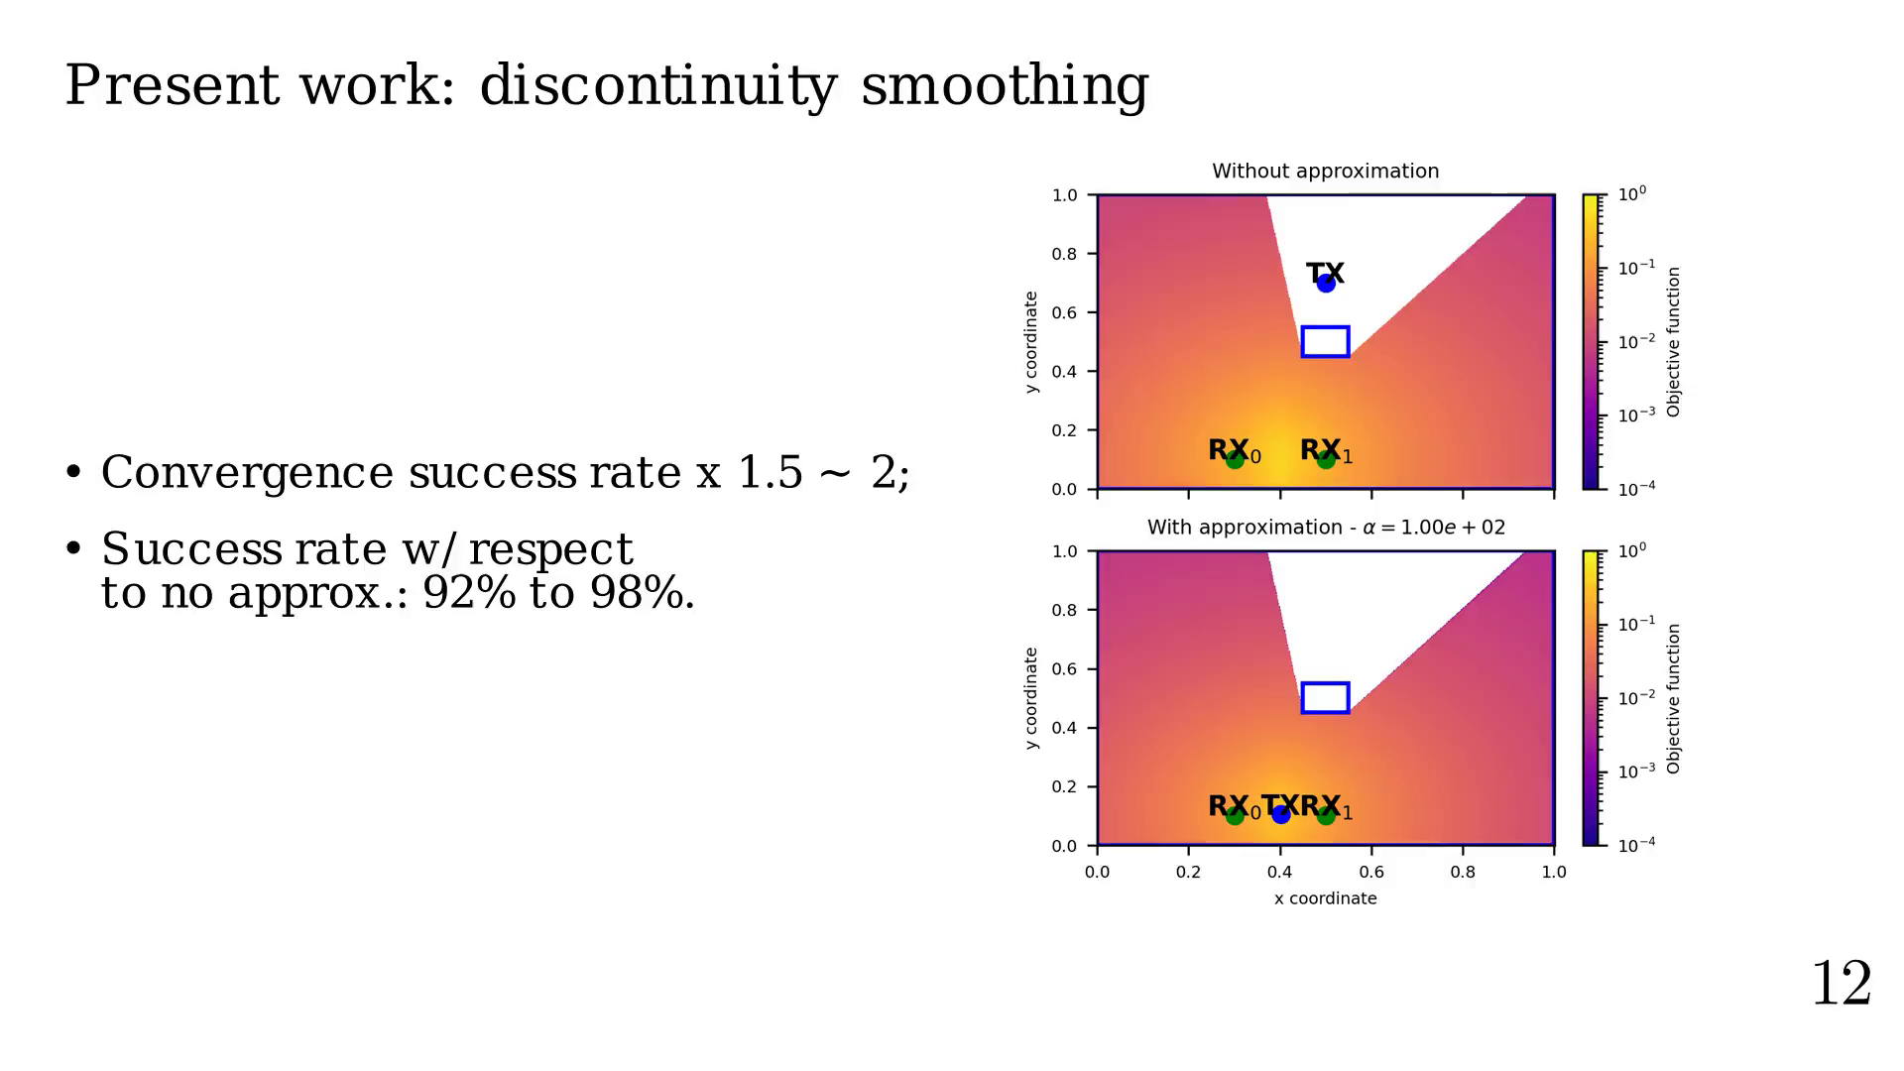
Notes:
Future work

Slide 41
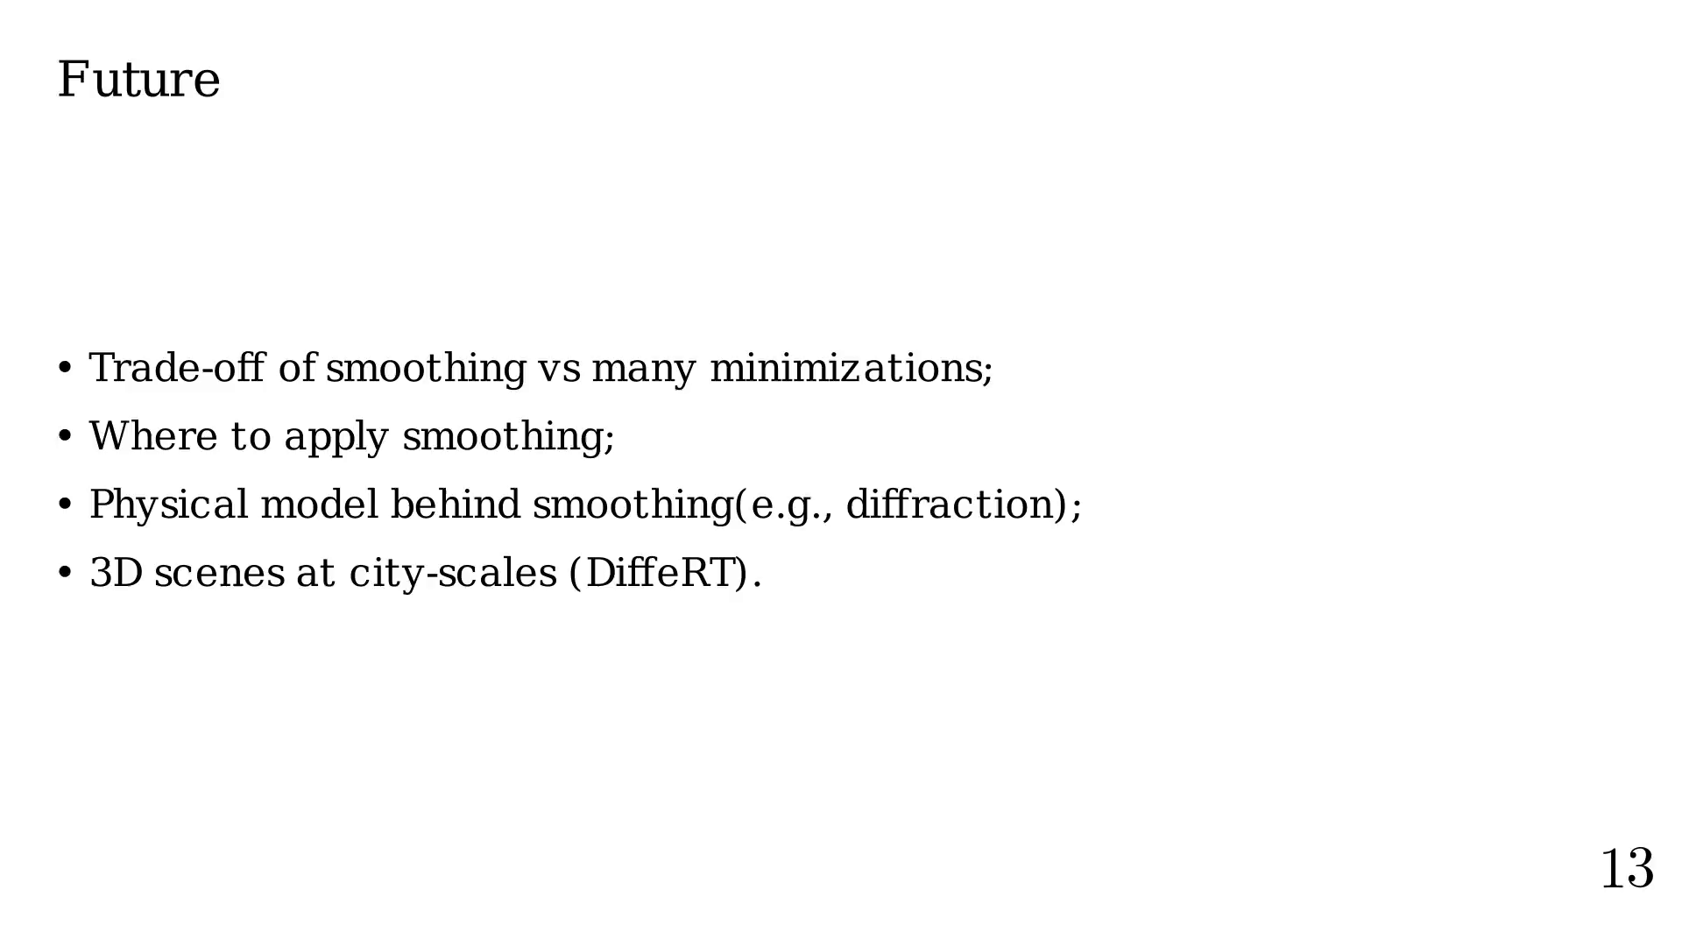
Notes:
Finals words

Slide 42

Notes:
That's all folks!

